Slide 1
Political Geography

Slide 2
Why Government?
In order to survive and prosper people set up organizations to protect their community and to enforce its rules - this is called government.

Slide 3
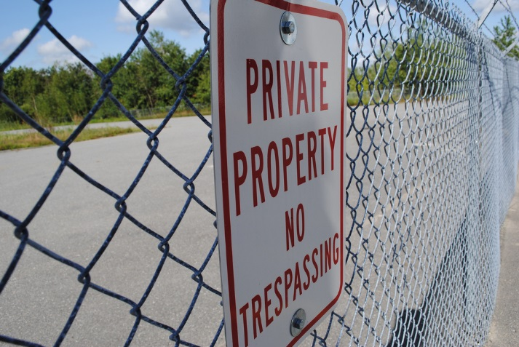
Role of Government
To protect the lives, liberties, and property of members of the community
To provide services that individuals cannot otherwise provide for themselves
To exercise authority, governments are given power or the authority to use forces.

Slide 4
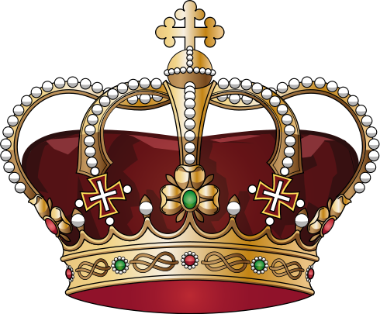
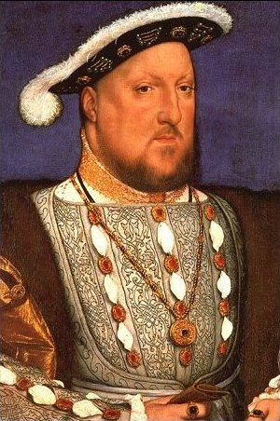
Monarchy
Oldest form of government, most countries during the middle ages had monarchies
Main characteristic of a monarchy is that the ruler inherits power
Kings and queens in a monarchy might claim absolute power
Also can be emperors or sultans
Rulers hold this power by “divine right,” or the will of God
current (absolute) monarchies: Saudi Arabia, Qatar, Oman, Swaziland

Slide 5
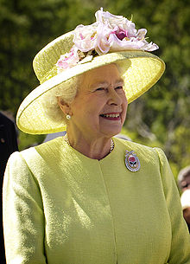
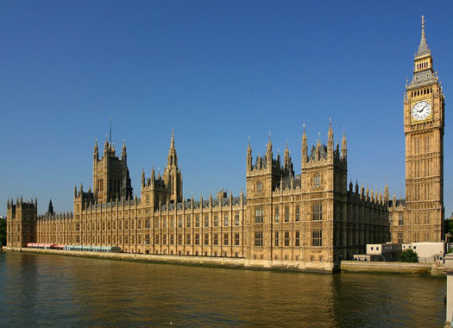
Constitutional Monarchy
Monarchs share power with an elected legislature
Monarchs are protected and serve as symbolic head of state
Elected members of Parliament govern the country
United Kingdom, Spain, Canada, Thailand, Sweden

Slide 6
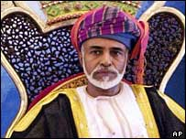
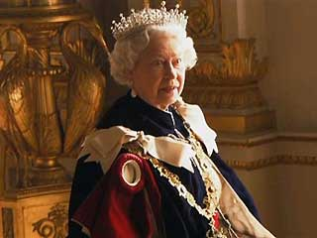
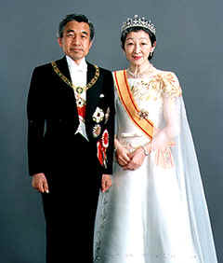
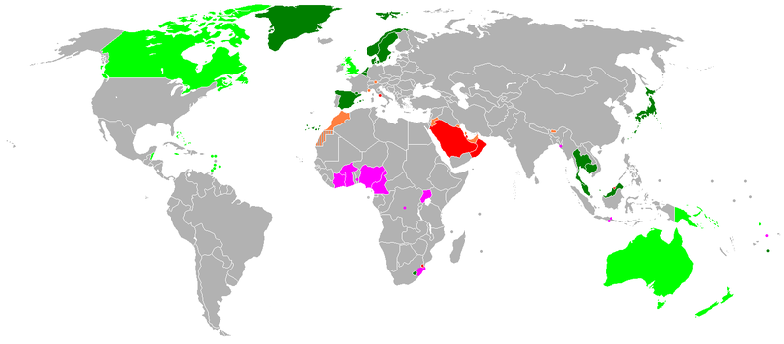
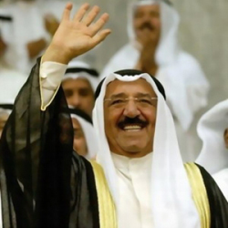
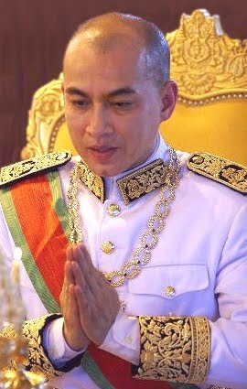
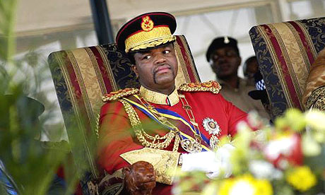
Qaboos Bin Said Al Said – Sultan of Oman
Queen Elizabeth - United Kingdom-constitutional monarchy
Imperial household of Japan (ko shitsu) oldest continuous hereditary monarchy in the world. Akihito.
Sheikh_Sabah_Al‑Ahmad_Al‑Jaber_Al‑Sabah. Kuwait is a constitutional monarchy
Mswati III of Swaziland, Africa’s last absolute monarch in the world.
Cambodia‑Sihamoni
Cambodia is a constitutional monarchy
Notes:
Some monarchs in the world today.

Slide 7
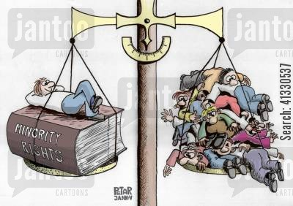
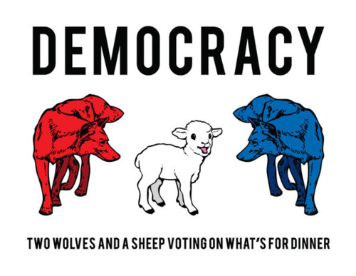
Republic
system of government where power rests in citizens who vote and representatives who stand for those citizens
Main distinction from democracy – individual rights of the minority are always protected

Slide 8
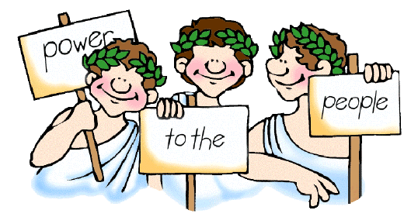
Democracy
Democracy is Greek for “people-power”.
Government authority is based on the will of the people.
People either vote on the issues directly, or they elect representatives who make government decisions for them.
Ancient Athens in 5th Century B.C. was the first known democracy.

Slide 9
Direct Democracy
In a direct democracy, issues are voted on directly by citizenry
Earliest democracies were direct due to low populations
No longer exist at the national level because not every citizen is able to participate
Does still exist at the local level in small towns

Slide 10
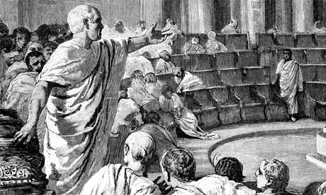
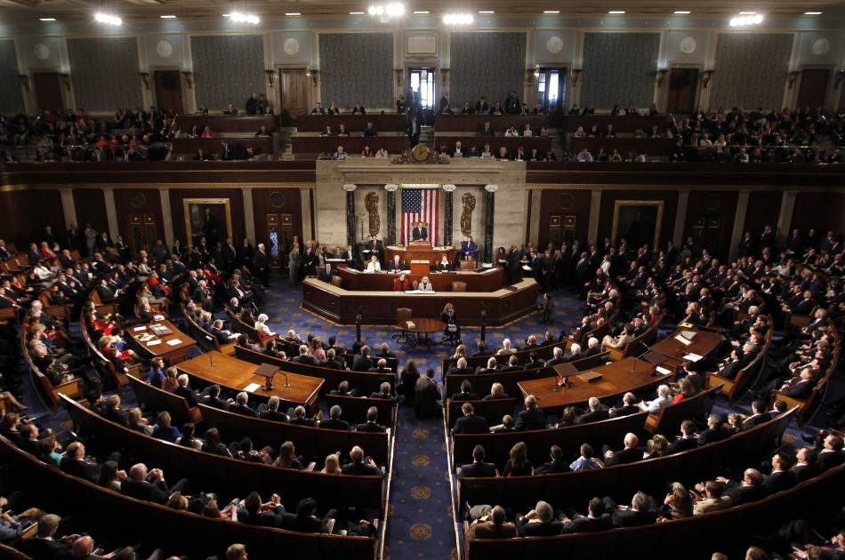
Representative Democracy
First developed by the Romans
Citizens elect different officials to represent them and their interests at different levels of government
Elected officials vow to vote in favor and in the interest of the electorate
Governmental power is divided between two or more branches

Slide 11
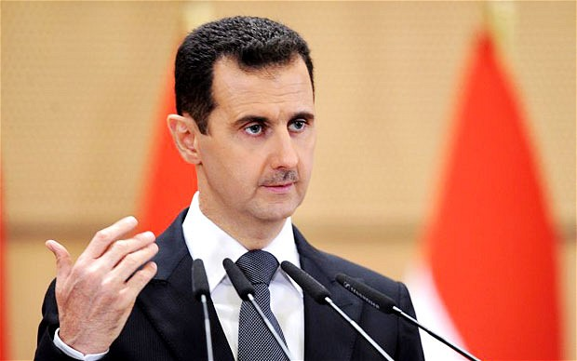
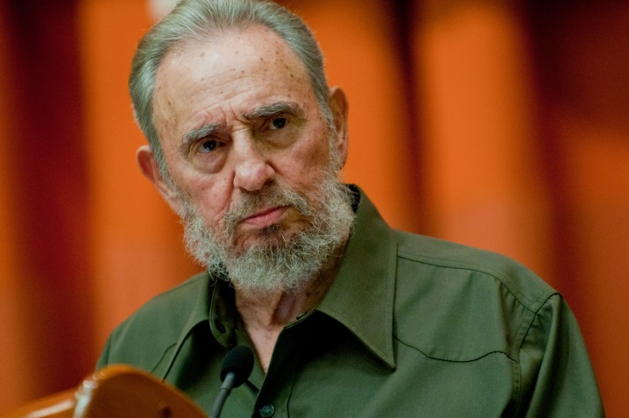
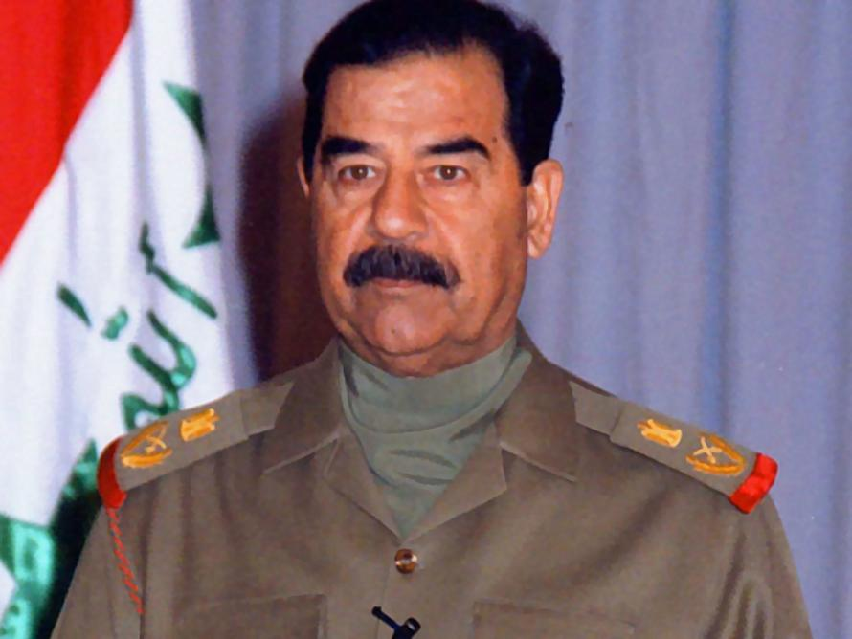
Dictatorship
Also known as “one-party” systems
A single person or small group rules without the consent of the governed
Power gained by force, or position of authority is given after a revolution
Citizens hold very few rights
Power is often, but not always, hereditary
Advantage: decisions are made quickly
Some countries in Latin America and Africa achieved their independence and became one-party states when the military leaders became dictators.

Slide 12
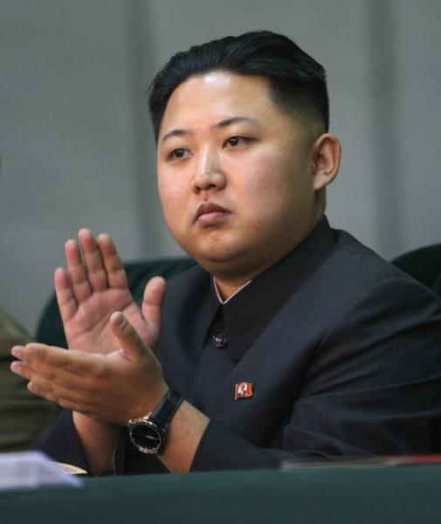
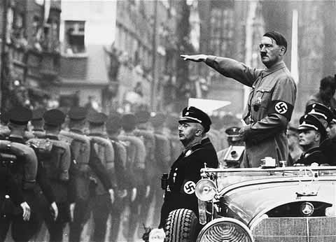
Totalitarian Systems
Government controls all aspects of individual life.
Gov.’t controls the police, military, communications, economy, education system, utilities, food supply, etc.
Gov’t controls television, radio, and newspapers – propaganda is common
Propaganda – the advertising of a certain ideology, usually a political agenda
Censorship of all books or articles criticizing the government.
Those who oppose the government are arrested and sent to labor camps or killed.
All leaders of totalitarian systems are dictators, but not all dictatorships are totalitarian

Slide 13
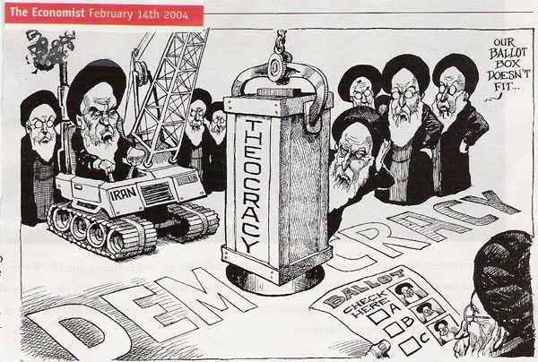
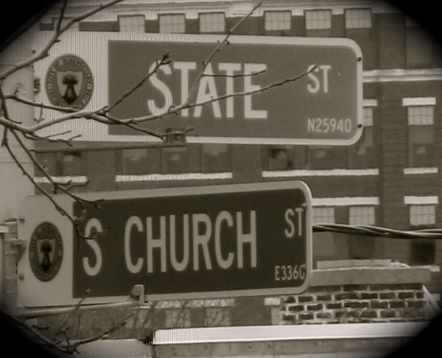
Theocracy
Government run by religious leaders; also a very old form of government.
The government claims to be directed by God, or divinely blessed.
No legal separation between church and state.
Ancient times rulers were often priests

Slide 14
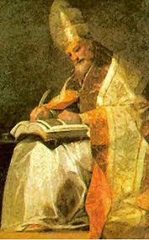
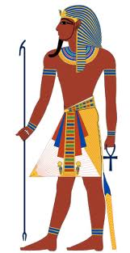
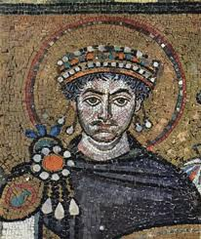
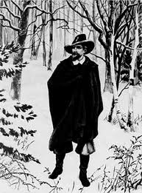
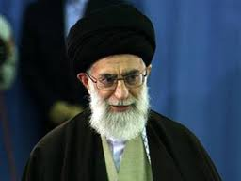
Examples of Theocracy throughout history.
The Byzantine Empire was ruled by an emperor who was also head of the church.
In the Middle Ages, the head of the Catholic Church, the Pope, ruled extensive territories in Italy.
Pharaohs of ancient Egypt were believed to be gods.
Iran, has both a theocratic and democratic government. The President and representatives are elected but are controlled by the Supreme Leader.
In early colonial times, Puritan ministers helped govern Massachusetts.
The Supreme Leader is an Islamic cleric appointed for life.
Notes:
Picture left to right.
Pharaoh of Egypt
Emperor Justintine – Byzantine Empire
Pope Gregory VII of Rome
Puritan minister
Supreme leader of Iran, Ayatollah Ali Khamenei.
Interprets religious law (Islamic Law – Sharia), can dismiss the President, and can declare war.

Slide 15
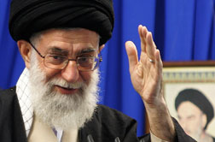
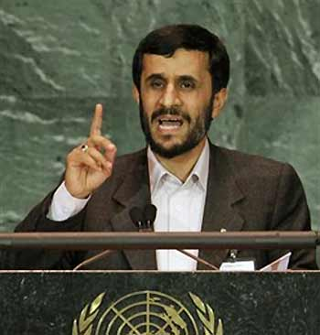
Iran’s Theocracy
Today, Iran has both a theocratic and democratic government.
Voters elect the President and representative to the legislature.
Iran’s religious leader is the head of state or Supreme Leader.
He is appointed for life and is the head of government, even above the president.

Slide 16
Political Geography
There are 196* countries in the world today.
Countries have independent governments, territory, and borders.
The area that a government controls creates a political region.
Governments can only create and enforce laws within their borders.
Political maps are designed to show boundaries separating different countries – these are known as borders.

Slide 17
Borders
Every nation has fixed borders
Several factors can determine borders…
Physical features
Historical circumstances
Political agreements
There are 3 types of geographic boundaries:
Natural – based on physical features
Cultural/Political – based on cultural/political traits
Geometric – based on regular, geometric patterns

Slide 18
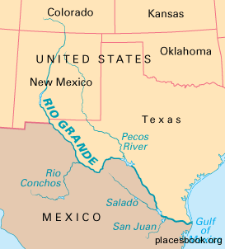
Natural Borders
Conform to physiographic features in the landscape such as rivers and mountain ranges
Examples:
Rio Grande between Texas & Mexico
Pyrenees Mts. between Spain & France
Great Lakes between U.S. & Canada
Lake Chad in Africa

Slide 19
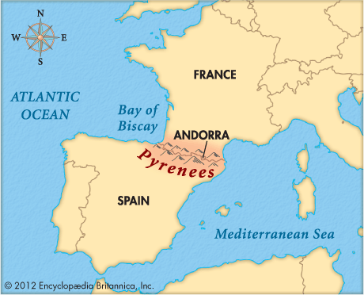
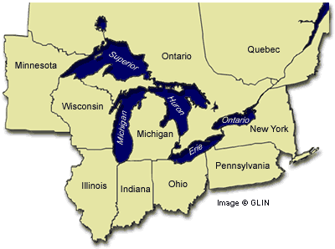
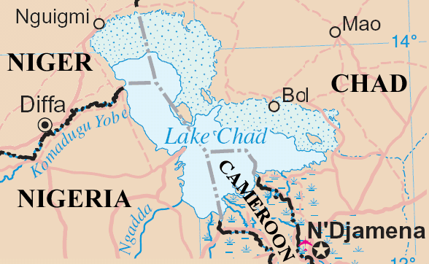

Slide 20
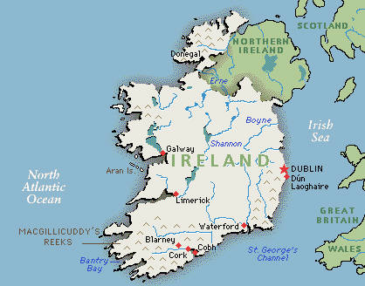
Cultural/Political Borders
Mark breaks in the human landscape
Examples:
Ireland & Northern Ireland
Israel & Palestine
Sudan & South Sudan
India & Pakistan

Slide 21
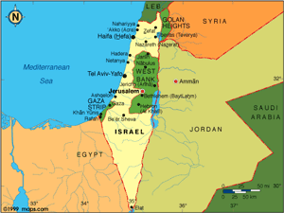
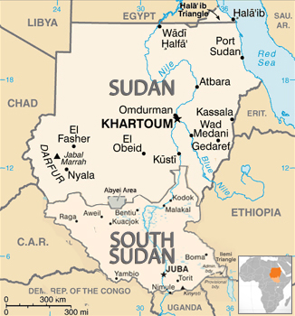
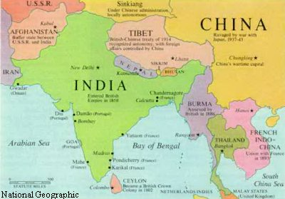

Slide 22
Geometric Borders
Can be straight line or curved boundaries
Totally unrelated to any aspects of the cultural or physical landscape
May follow lines of latitude/longitude
Examples:
North African nations
U.S. & Canada west of the Great Lakes
Western states of the U.S.
North Korea…sort of

Slide 23
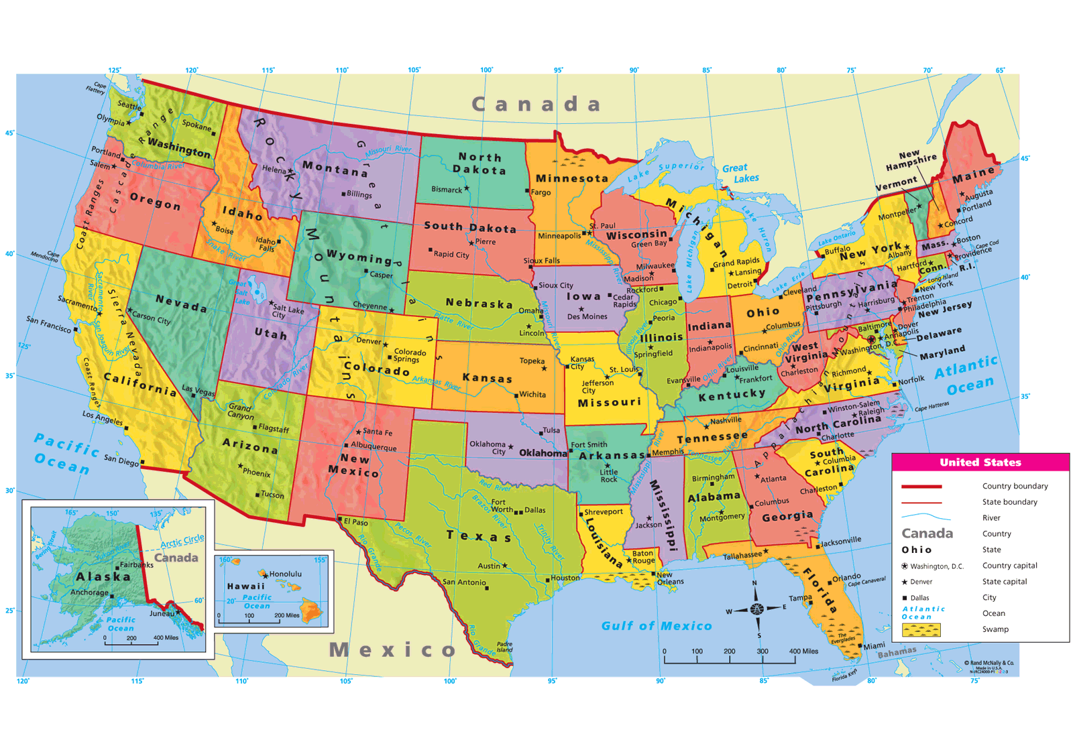
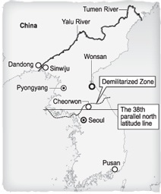
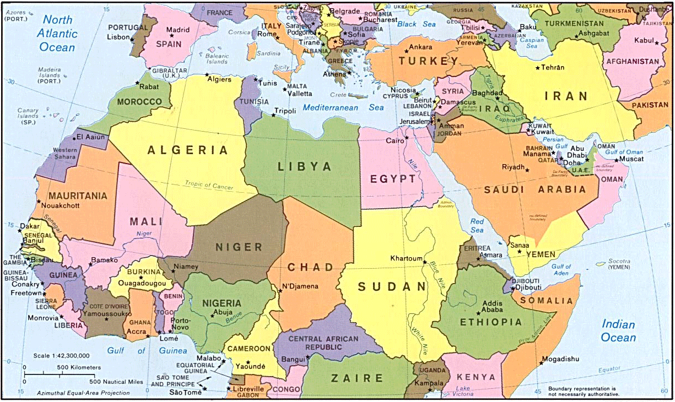

Slide 24
Shifting Borders
Borders have changed and will continue to change over time.
Some countries may lack natural, defensible borders and may be more susceptible to change

Slide 25
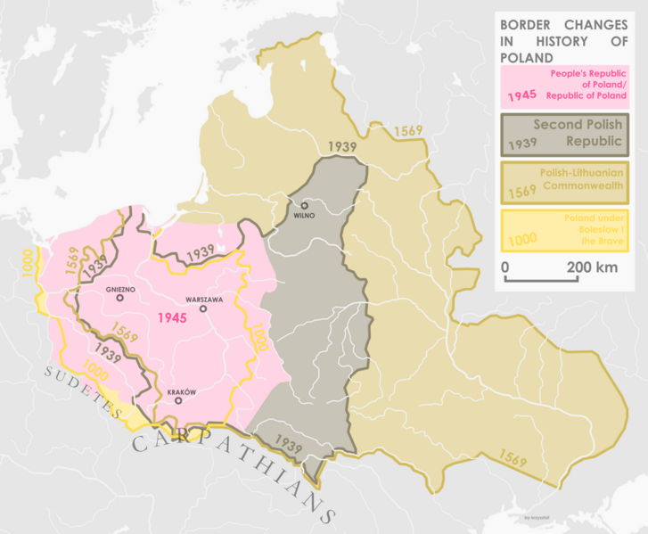
Shifting Borders - Poland
Lacking defensible borders the country of Poland has expanded and contracted throughout history

Slide 26
Shifting Borders – Israel & Palestine
1947 - United Nations voted in favor of creating a new Jewish state.
1948 - Israel declares independence and Arab states immediately declare war on Israel.
Israeli – Palestinian conflict continues until this day

Slide 27
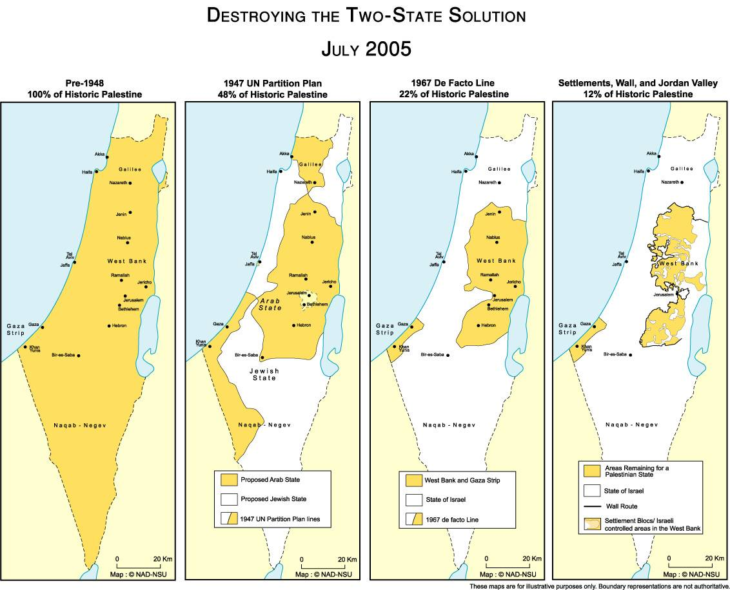

Slide 28
Shifting Borders – The United States
America’s borders were expanded and determined by purchase, conquest, and geography.
United States territory expanded westward since independence in 1783.

Slide 29
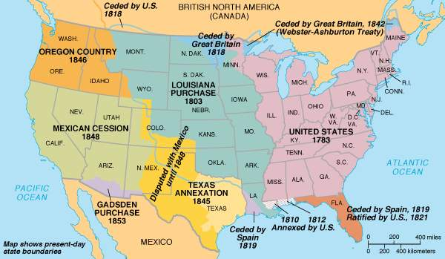

Slide 30
Levels of Government
Each country has levels of government, such as:
Cities
Counties
States (provinces)
National (federal)
A sovereign government is one that is not subject to any higher authority.
Our national (federal) government is our highest level of government.
“Supremacy clause” in the U.S. Constitution states that when state and federal laws conflict, federal law takes precedence.

Slide 31
International Relations
Nations compete and even conflict with each other in order to protect themselves and seek greater security.
Nations often form trade agreements amongst each other and even form alliances in the event of international conflict.

Slide 32
“Balance of Power”
Refers to the idea that if one country becomes too strong other weaker countries will band together against it.
Purpose of this “balance” is to prevent any single nation from becoming so powerful that it forces its will upon other nations.
Ex. Cold War

Slide 33
United Nations (UN)
The United Nations is an organization of all sovereign nations in the world.
Founded after WWII
Purpose is to promote peace, prevent war, and encourage development throughout the world.
Headquartered in New York City
193 members, non-members are: Kosovo, Taiwan, Vatican City

Slide 34
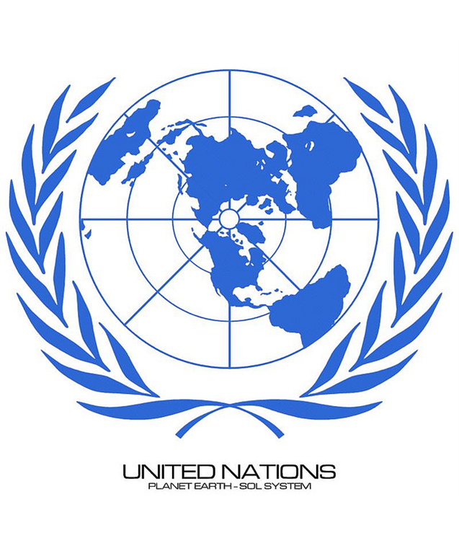
United Nations (UN)
All members are part of the General Assembly
5 nations are permanent members of the Security Council
USA
China
Russia
France
United Kingdom
10 non-permanent members are elected every 2 years

Slide 35
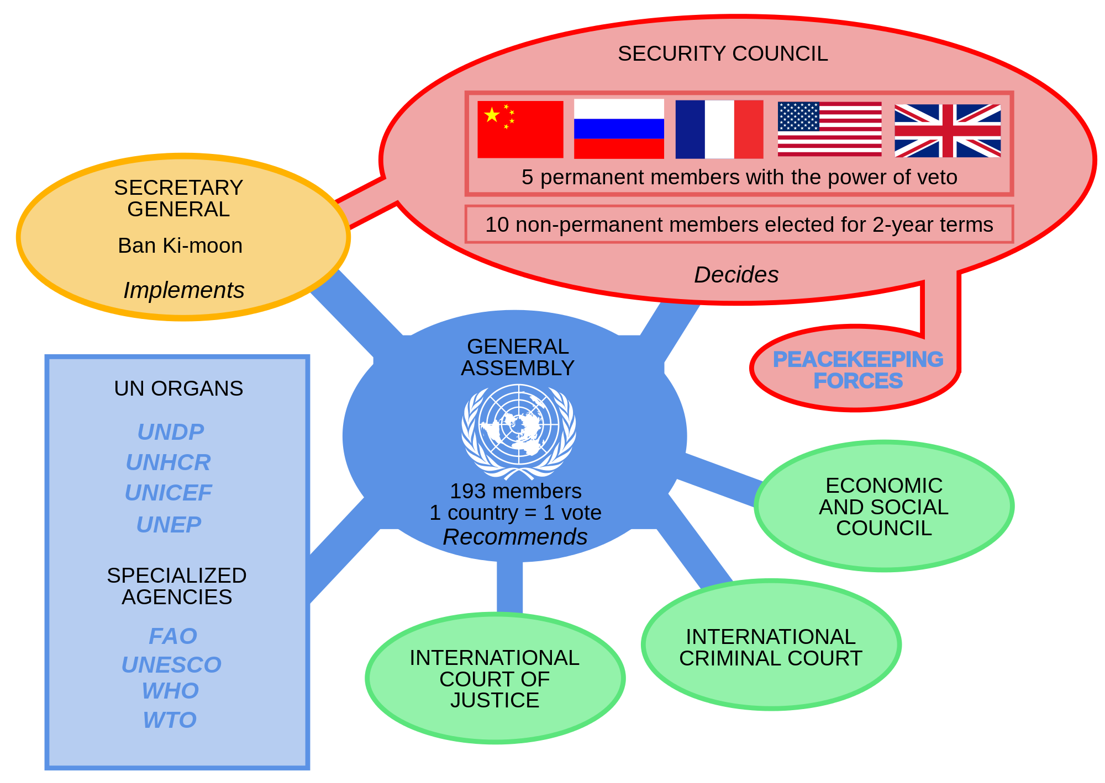

Slide 36
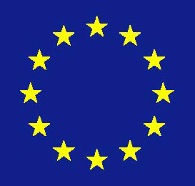
European Union (EU)
Is an economic and political association of European countries.
Promotes free trade and free movement of people within member countries
Uses the Euro as an international currency*
Citizens elect representatives to the European Parliament headquartered in Strasbourg, France

Slide 37
