Slide 1
Maps and Map Skills

Slide 2
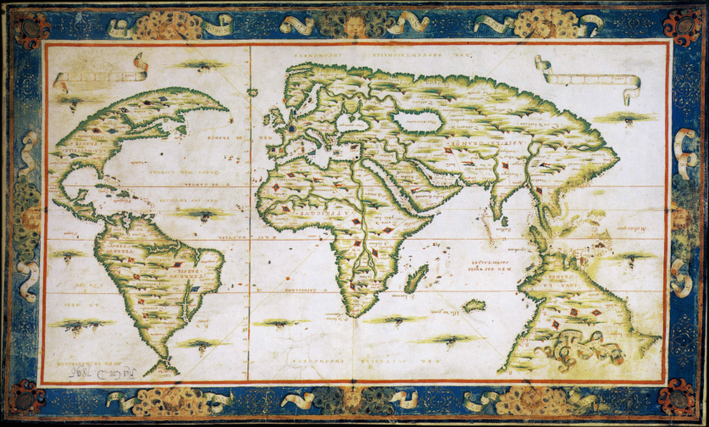
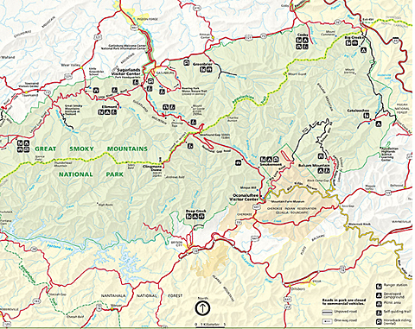
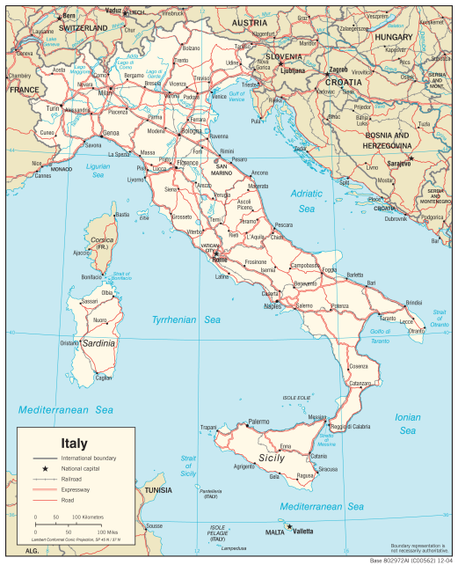
What is a map?
A flat, 2 dimensional representation of earth or a selected place, can show selected elements or features of a place

Slide 3
Map Projections
A map projection in a systematic transformation of latitudes and longitudes of locations of a 3-D world onto a flat surface.
Common projections for earth:
Mercator
Robinson
Goode’s Homolosine Equal-Area
There is no limit to the number of map projections possible.
No projection is 100% accurate, each will have some level of distortion (changes in the shape of an object)

Slide 4
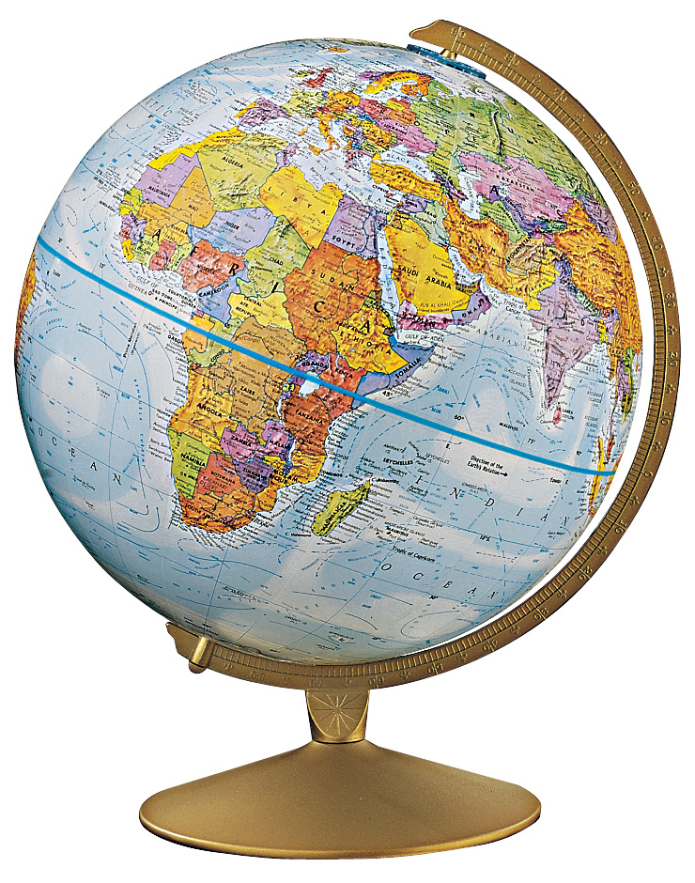
A globe is the BEST representation of Earth, due to it’s spherical nature. But, is impractical to use and does not include as much detail as a map can.

Slide 5
Parts of a Map
Every good map will include these essential elements:
title
scale
compass rose
legend/key

Slide 6
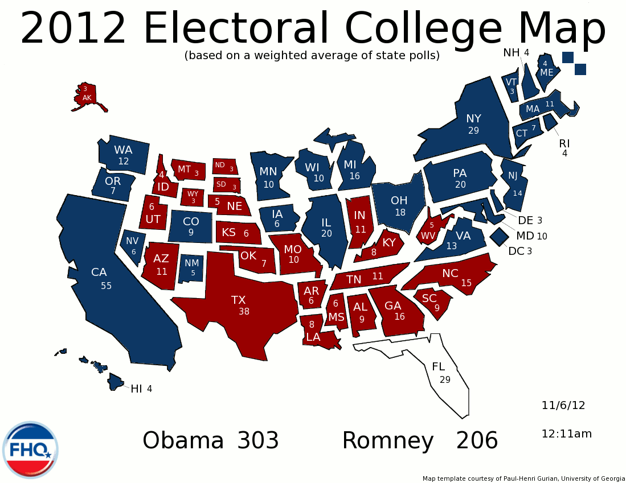
Title
Should be the first thing you look at
Will frame your mind set for what you are about to look at
Will state obvious information as to what the map is depicting
Example:
“Mexico before Independence”
“China: Natural Resources”
“Mid-Atlantic Triangle Trade”
“The Spread of Islam”

Slide 7
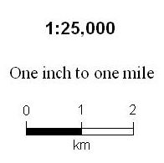
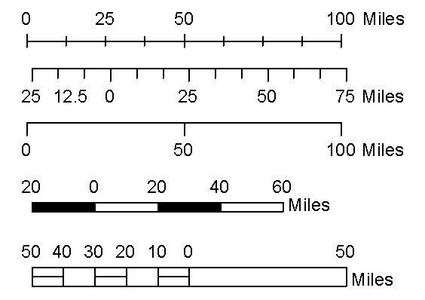
Scale
Shows the relationship between distance on a map and distance on the ground
Will give you an idea of how much ground the map covers
Maps with larger scales will cover more ground than those with smaller ones
Ex. 1in = 1 mile
very small scale
Ex. 1in. = 100,000 miles
very large scale

Slide 8
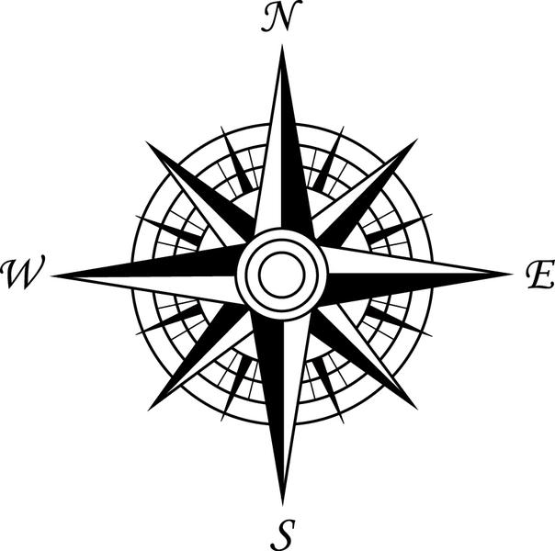
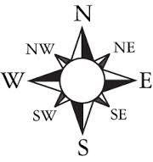
Compass Rose
Symbol on a map that indicates cardinal directions
North, South, East, West
Can sometimes include intermediate directions
NW, NE, SW, SE
Can also be as simple as an arrow pointing North, all others are supposed to be assumed based on that
DO NOT assume that a map is always oriented north

Slide 9
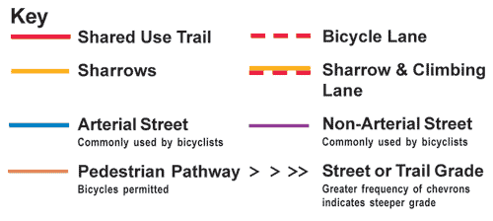
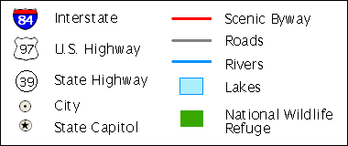
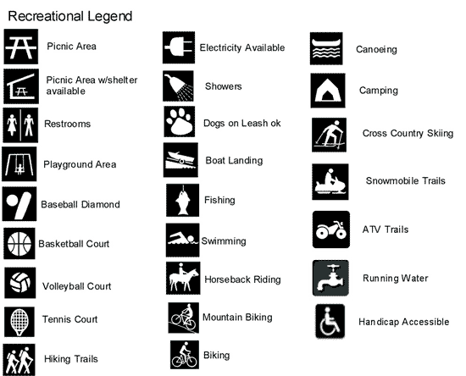
Legend or Key
Explanation of symbols and abbreviations used on a map
Most maps are not big enough to include labels for everything, so a legend/key comes in very handy
Will help make sense of the map
Second thing that should be looked at after the title

Slide 10
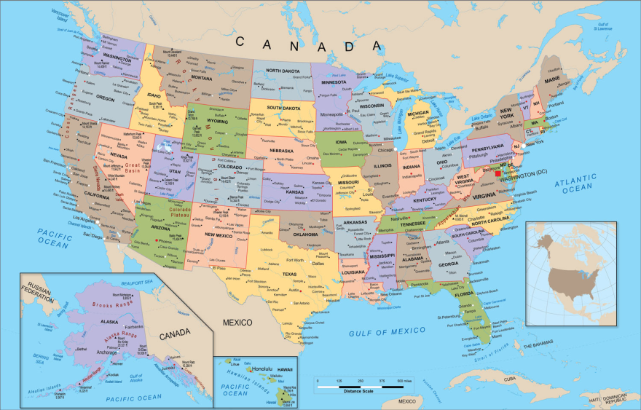
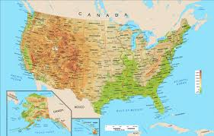
Types of Maps
There are 7 major types of maps:
Physical
Political
Topographic
Climate
Resource/Economic
Street/Road
Thematic

Slide 11
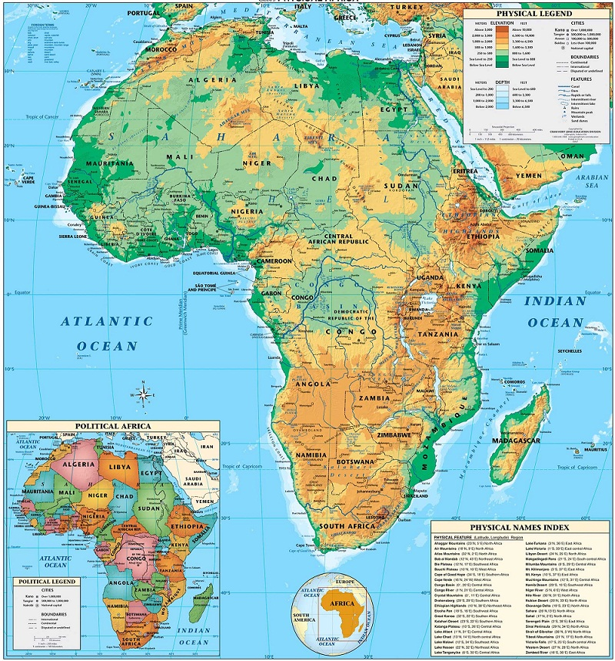
Physical Map
Shows the major physical features of an area, focuses on the natural environment
Rivers
Mountains
Vegetation
Bodies of water

Slide 12
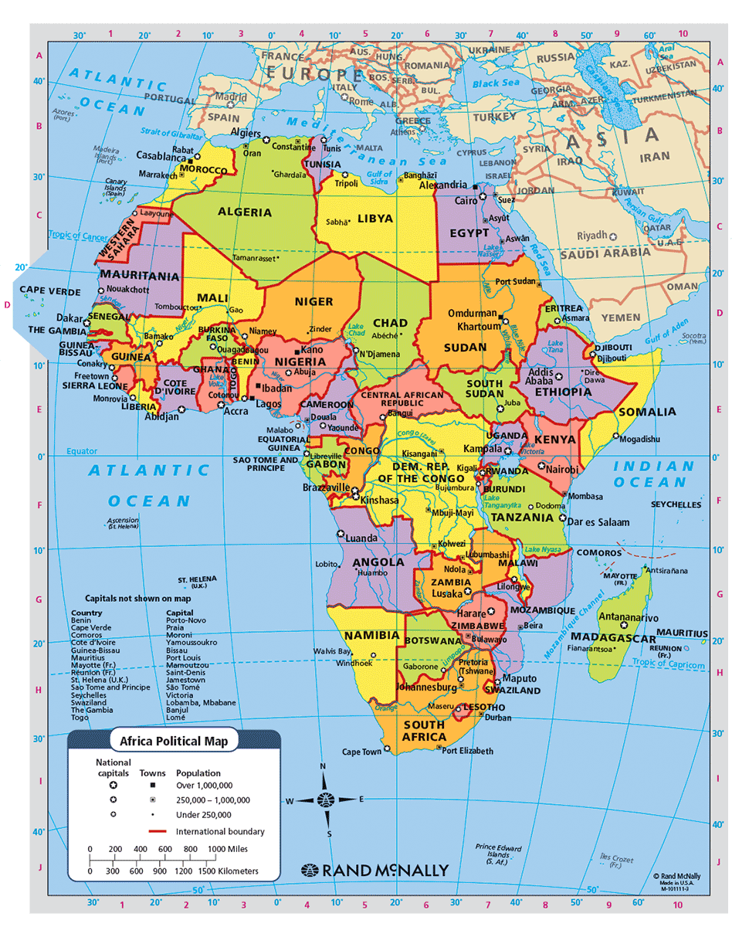
Political Map
Shows the boundaries of states, countries, or other governmental divisions.
Will usually show capitals and major cities

Slide 13
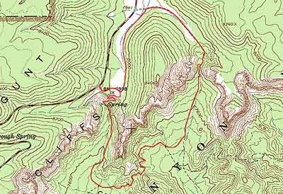
Topographic Map
Shows natural and man-made features of the land, marked by contour lines showing elevation and shape of the land

Slide 14
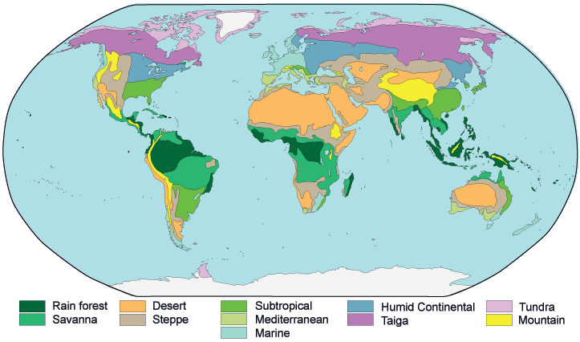
Climate map
Gives information about the climate and precipitation of a region

Slide 15
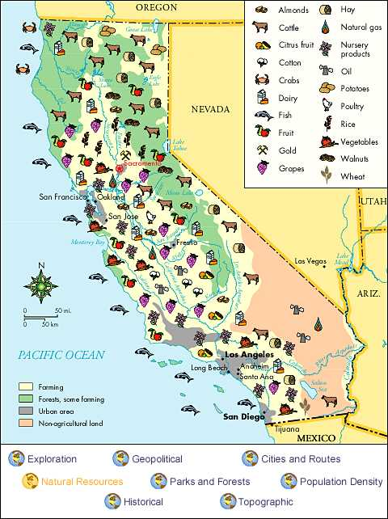
Resource/Economic Map
Show the major natural resources and agricultural and industrial products of an area.
Will use color coding and many symbols

Slide 16
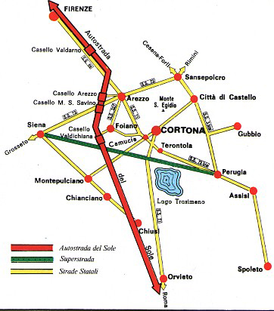
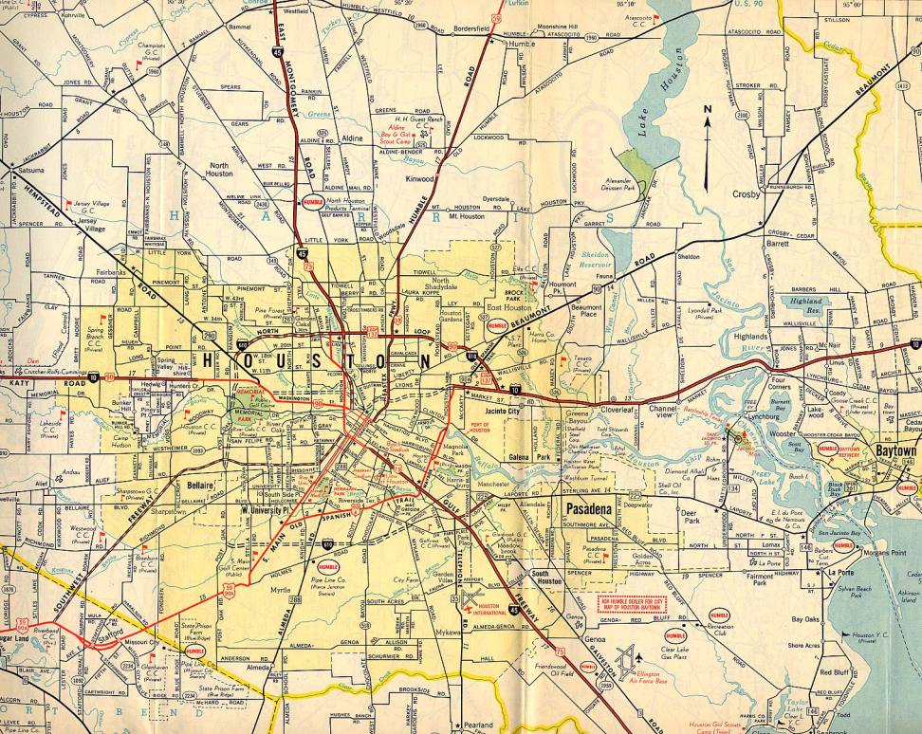
Street/Road Map
Shows smaller areas such as cities and towns, used to find directions
Will highlight major roadways, street names, and important landmarks.

Slide 17
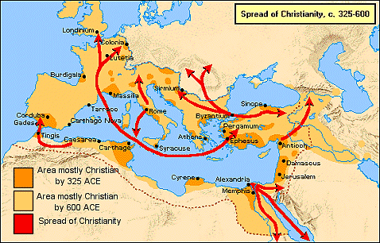
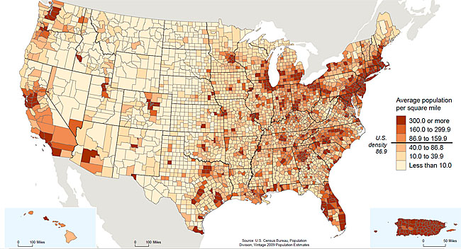
Thematic Map
Shows information relating to a specific theme. Ex:
Spread of religion
Trade routes
Population density
Are often combined with one of the other types of maps for added detail
Possibilities are endless!

Slide 18
When you first encounter a map…
Read the TITLE! This will tell you what you are about to look at.
Study the legend/key. It will tell you more details about what you will be looking at. Identify what the colors and/or symbols mean.
Find the scale. Are you looking at a large or small area?
Look at the compass rose. Identify which way is north.
Finally, look at the map. Identify the colors and symbols from the legend/key. Study the map carefully, comb through the details.

