Slide 1
External Forces Affecting Earth
Earth is also affected and shaped by external forces, they are weathering, erosion, and deposition

Slide 2
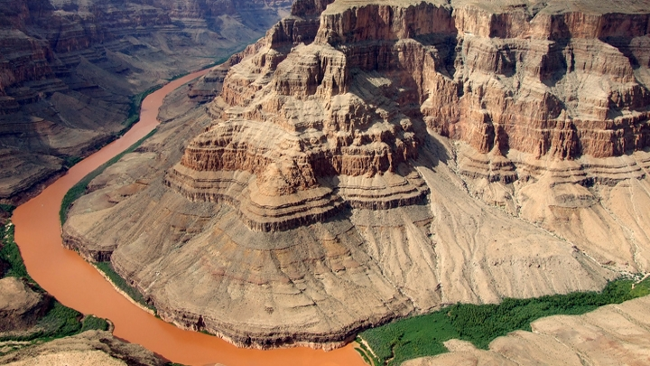
Weathering
The breakdown of Earth’s crust into smaller pieces
Smallest particles are called sediment

Slide 3
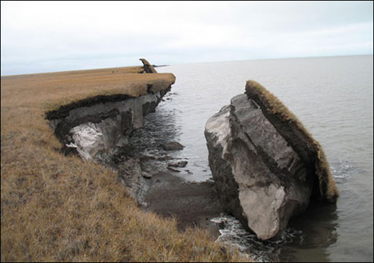
Erosion
The process by which weathered rock, sand, and soil are carried away and moved to a new location

Slide 4
Agents
3 main natural agents aid the process of weathering and erosion. They are:
Water
Ocean waves, rivers, streams, and runoff
Ice
Frost wedging, glacier formation & movement
Wind
Transports rock material against gravity

Slide 5
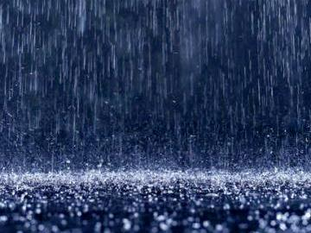
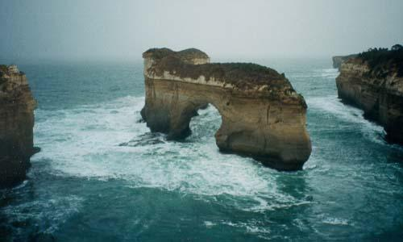
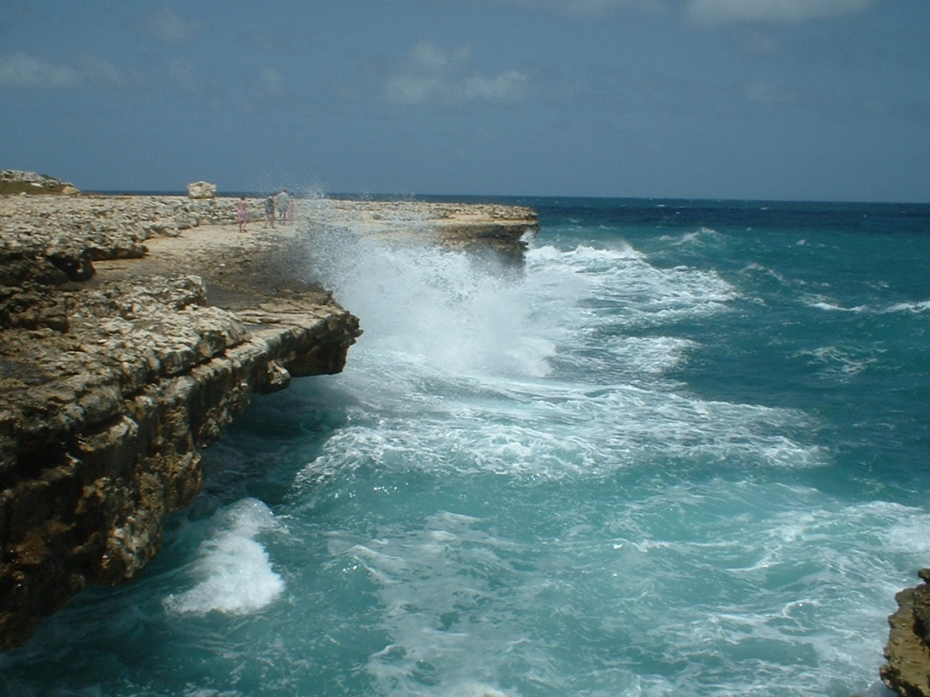
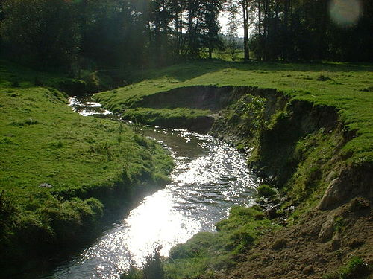

Slide 6
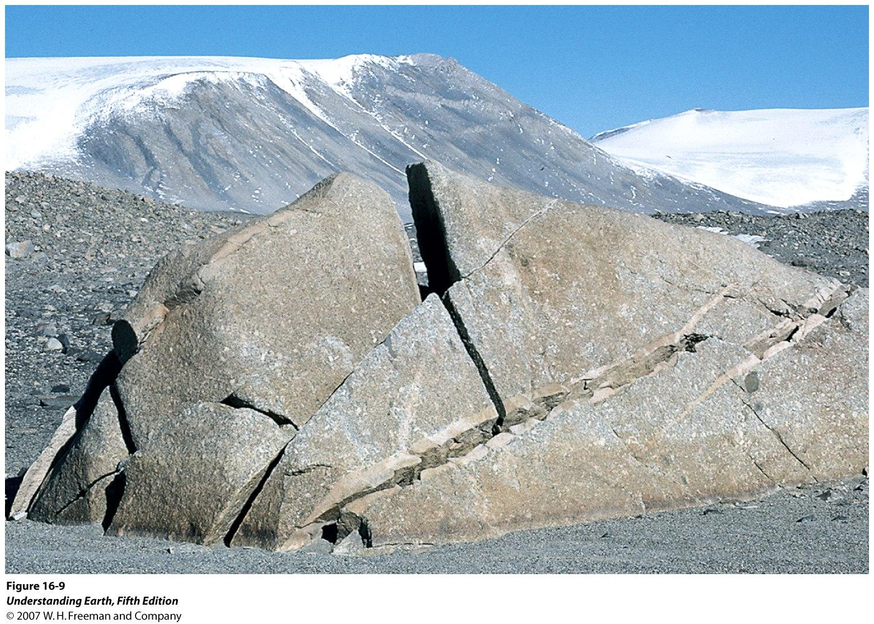
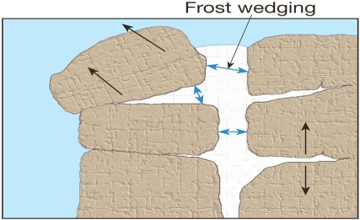

Slide 7
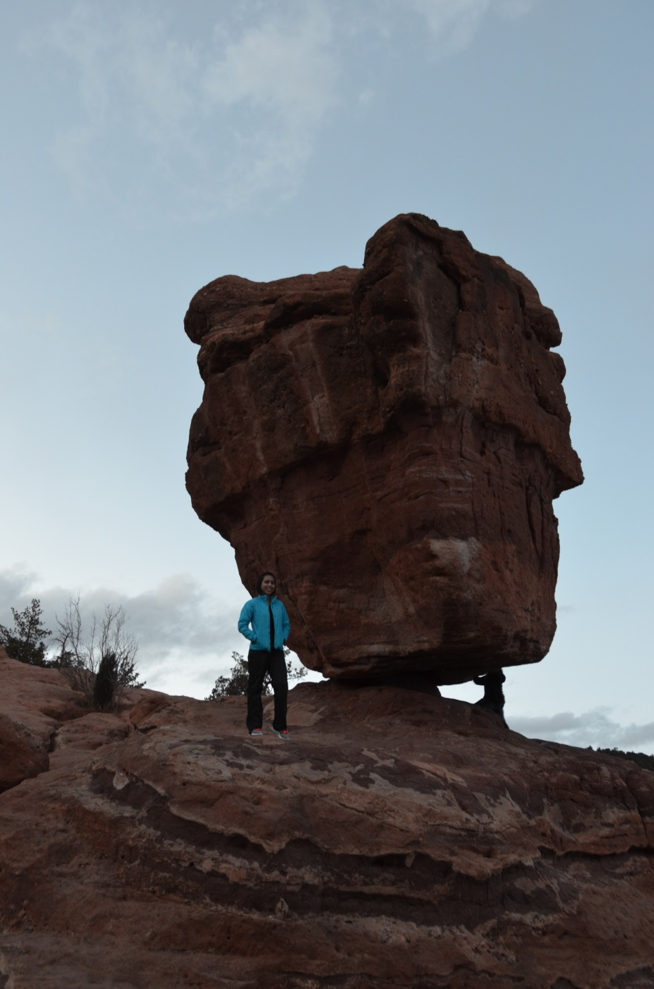
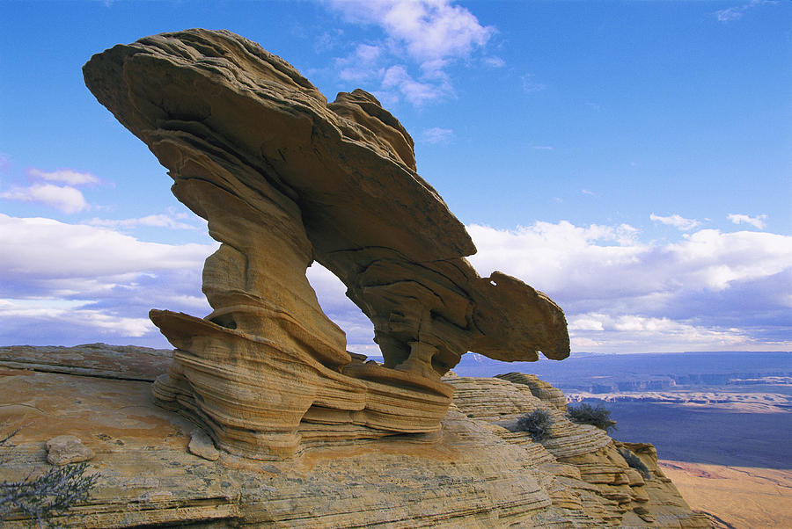
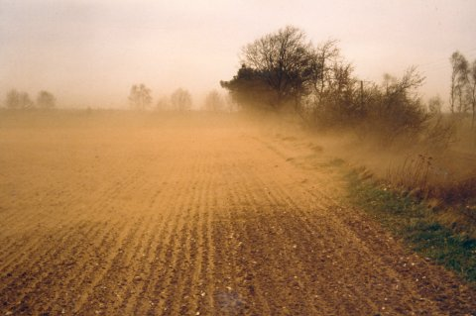
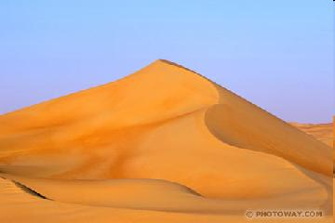

Slide 8
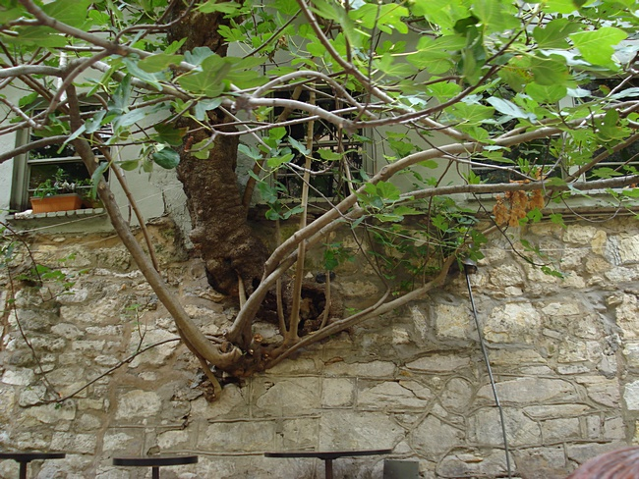
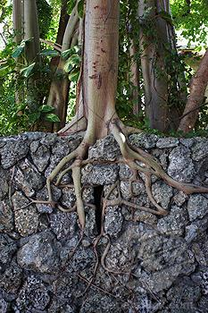
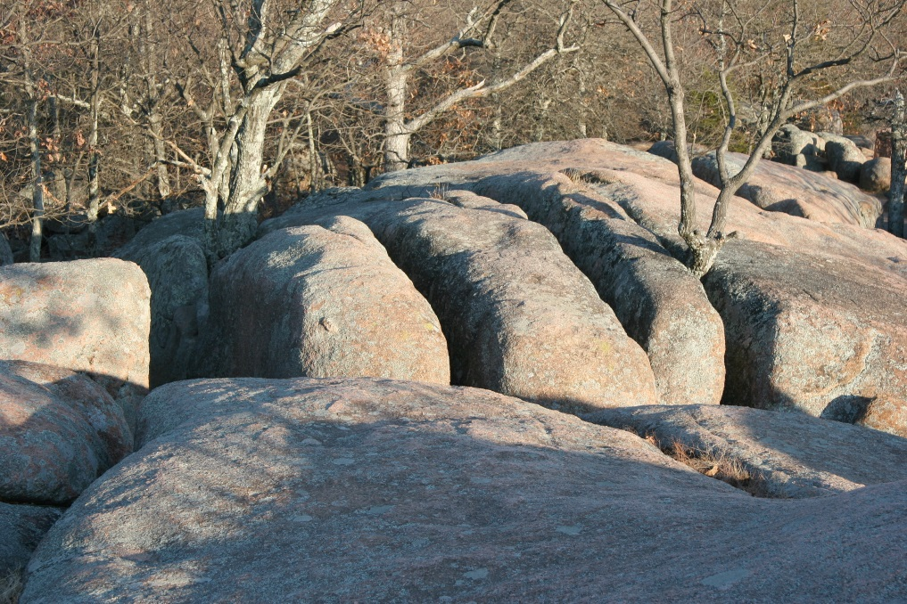
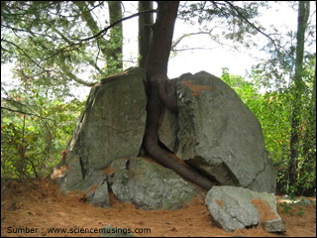

Slide 9
Deposition
The depositing of particles and sediment in a new location, resulting in the creation or growth of a landmass
Weathering
Erosion
Deposition

Slide 10
