Slide 1
Lithosphere
Processes shaping earth

Slide 2
Earth’s Systems (spheres)
Lithosphere - Earth’s crust and upper mantle
Atmosphere - Layers of gases surrounding Earth
Biosphere - Living organisms on Earth
Hydrosphere - Earth’s water

Slide 3
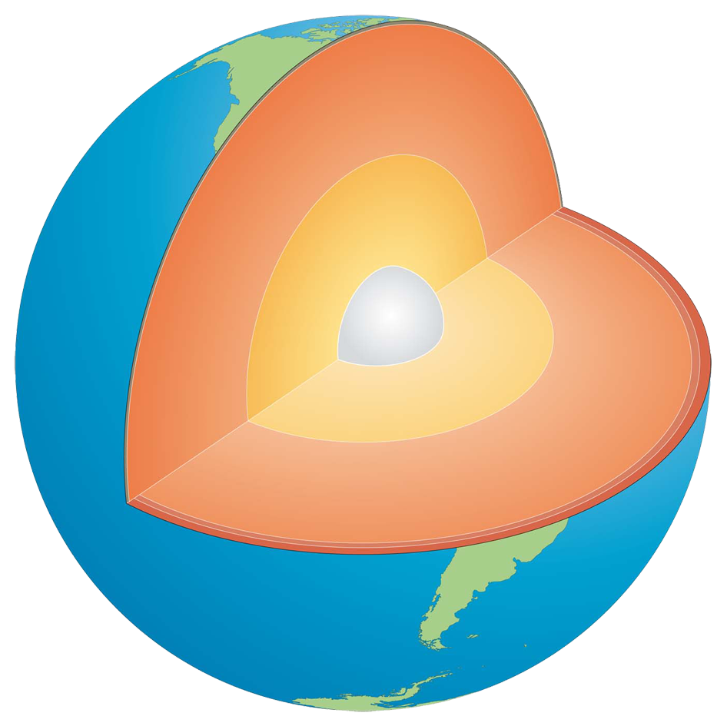
Structure of the Earth
The Earth is made up of 3 main layers:
Core (inner/outer)
Mantle
Crust
Mantle
Outer core
Inner core
Crust

Slide 4
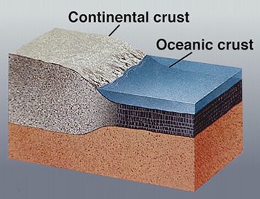
The Crust
The outermost layer - where we live!
There are 2 types of crust: continental and oceanic
Continental crust:
Thick (10-70km)
Buoyant (it “floats” – less dense than oceanic crust
Mostly old
Oceanic
Thin (~7km)
Dense (sinks under continental crust)
young

Slide 5
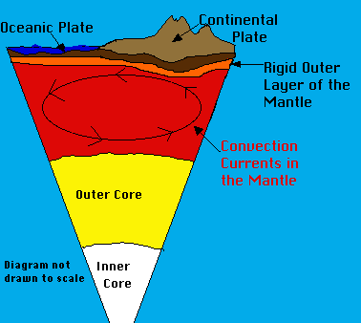
The Mantle
Region of hot, dense rock
Upper portion of it is solid
Deeper under the surface, rock becomes semi-solid or plastic
Convection takes place in the mantle

Slide 6
Convection
is the transfer of heat by the movement of the heated parts of a liquid or gas.
hotter, less dense material rises
cooler, denser material sinks under the influence of gravity

Slide 8
Plate Tectonics
Earth’s crust is divided into 12 major plates which move in various directions
This plate motion causes them to collide, pull apart, or scrape against each other.
They move a few centimeters each year.
Each type of interaction causes a characteristic set of Earth structures, or “tectonic” features.
Plate tectonics = Plate Interactions

Slide 9
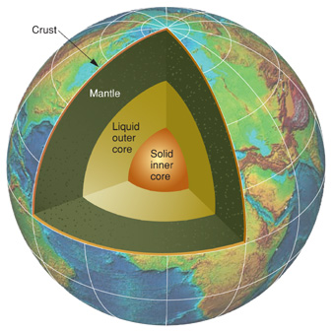
The Core
Deepest and hottest layer, divided into inner and outer core
Made of mostly nickel and iron
Inner core is solid, outer is liquid

Slide 11
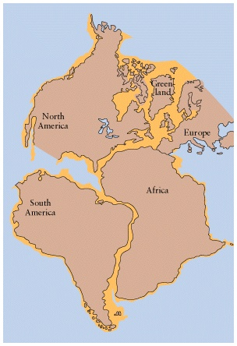
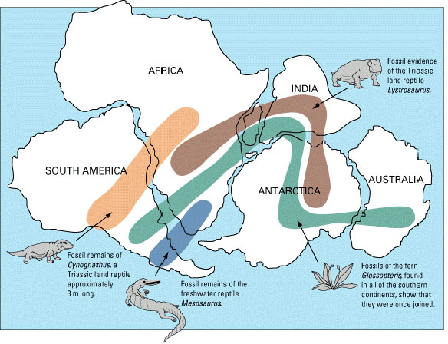
Continental Drift
Alfred Wegener’s theory:
Earth was once a supercontinent
Over time, the continent split into plates that move
Evidence:
Current layout of the continents – “puzzle pieces”
Fossils – plants and animals found in non-native places

Slide 12
How do you think today’s continents were once joined?

Slide 13
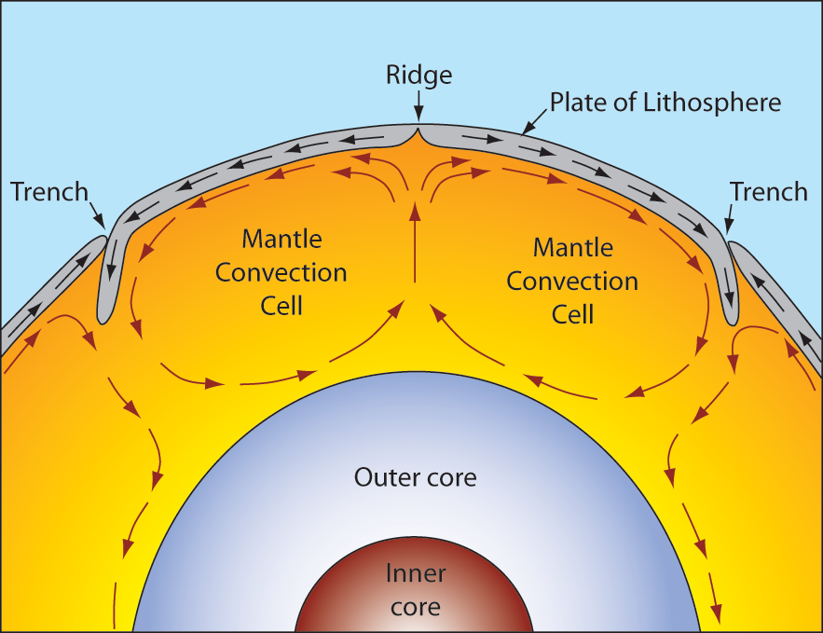
Plate Boundaries
Convection leads to plate tectonic movement
3 different types of boundaries result:
Divergent
Convergent
Transform

Slide 14
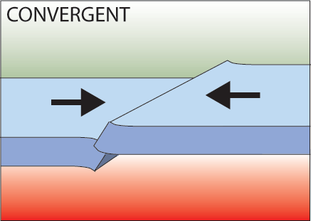
Convergent Boundaries
Boundaries between 2 plates that are colliding, can be:
Continent-continent collision
Continent-oceanic crust collision

Slide 15
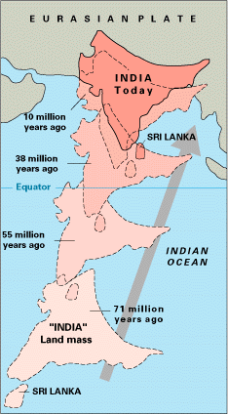
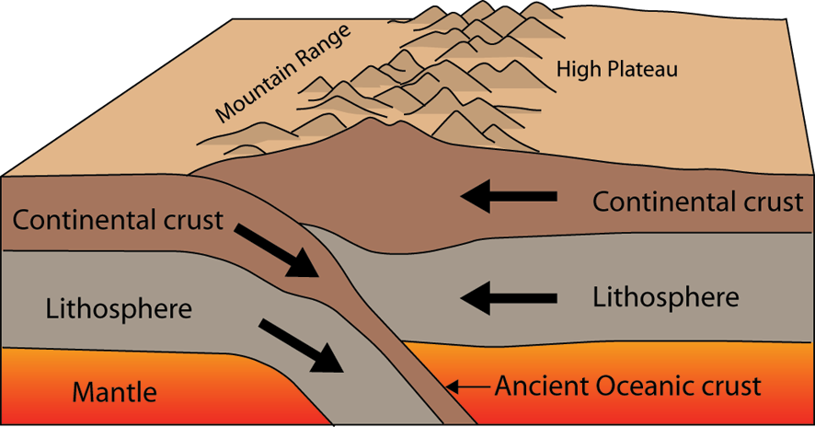
Continent-Continent Collision
Forms mountains, ex: Alps, Himalayas

Slide 16
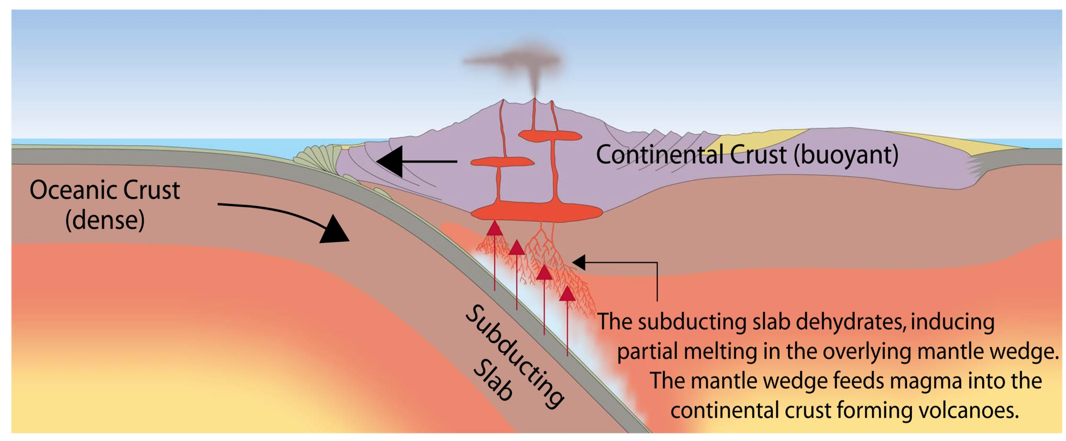
Continent-Oceanic Crust Collision
Oceanic crust (more dense) will sink under continental crust (more buoyant); called subduction
Subduction is a way of recycling the oceanic crust
Can result in the creation of volcanoes and mountains

Slide 17
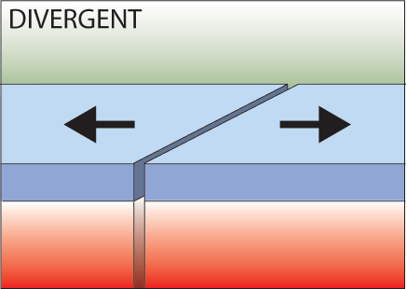
Divergent Boundaries
Boundaries between 2 plates that are moving apart or rifting
Can form in the middle of continents or on the ocean floor (seafloor spreading)
Creates rift valleys and causes volcanic activity

Slide 18
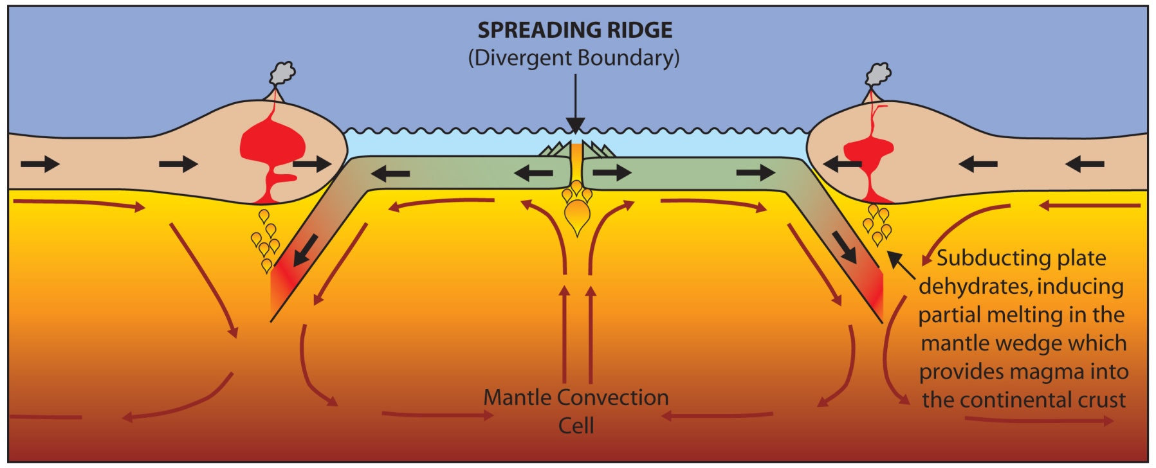

Slide 19
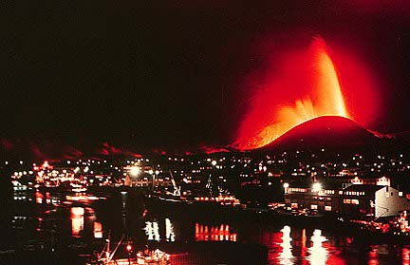
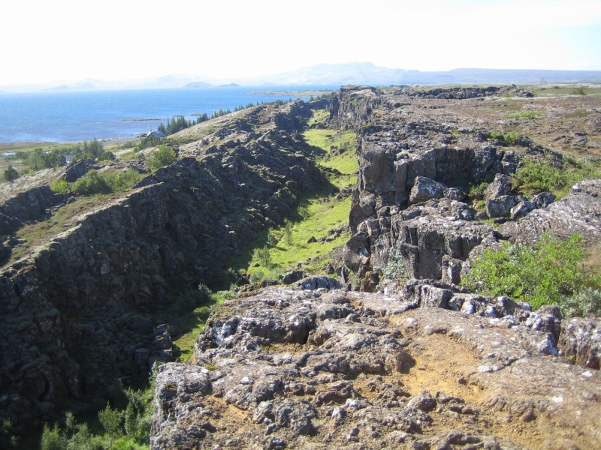
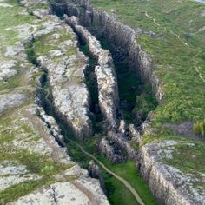
Iceland: An example of continental rifting

Slide 20
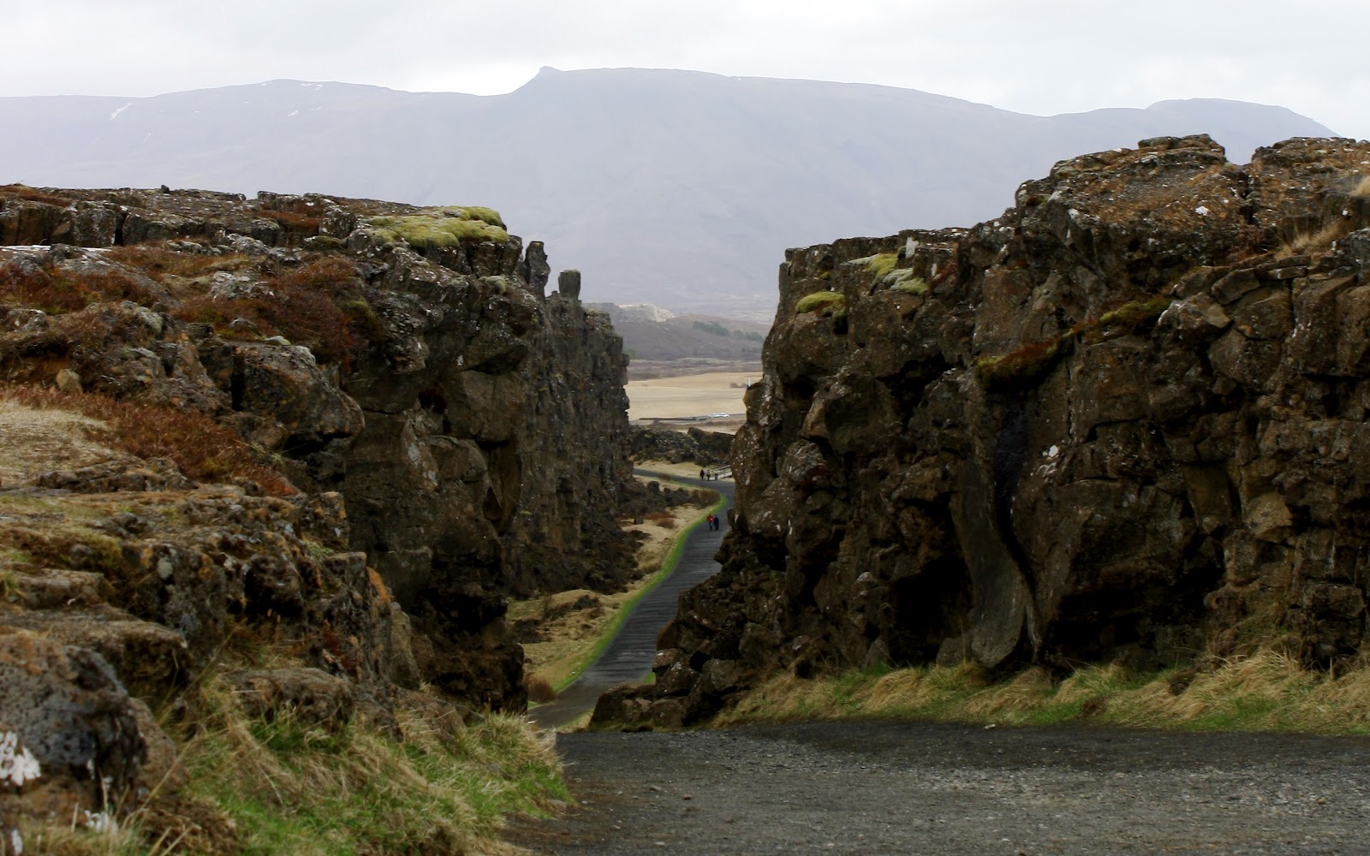
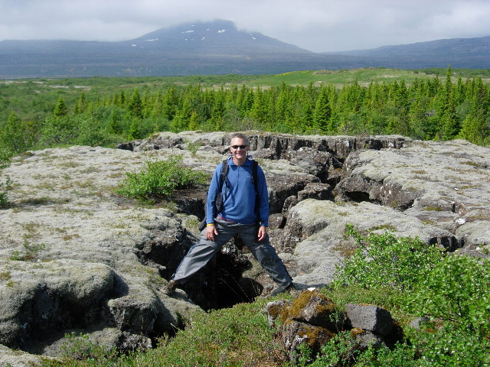
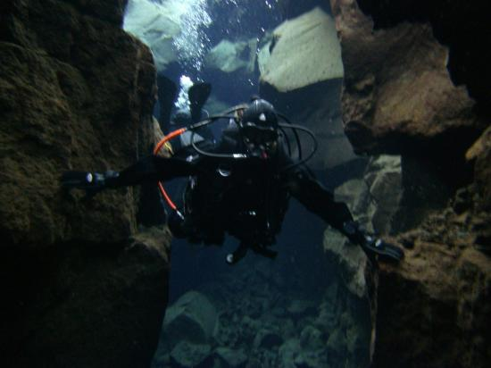

Slide 21
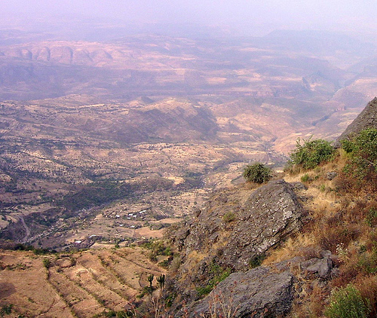
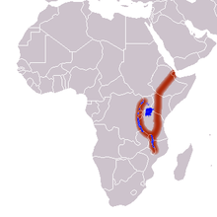
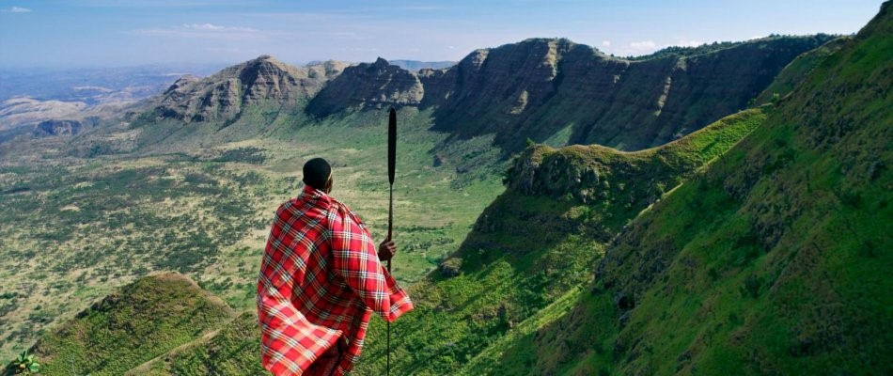
The Great Rift Valley: Africa

Slide 22
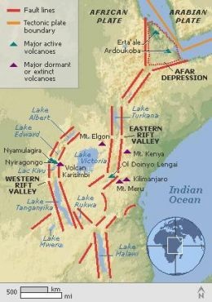
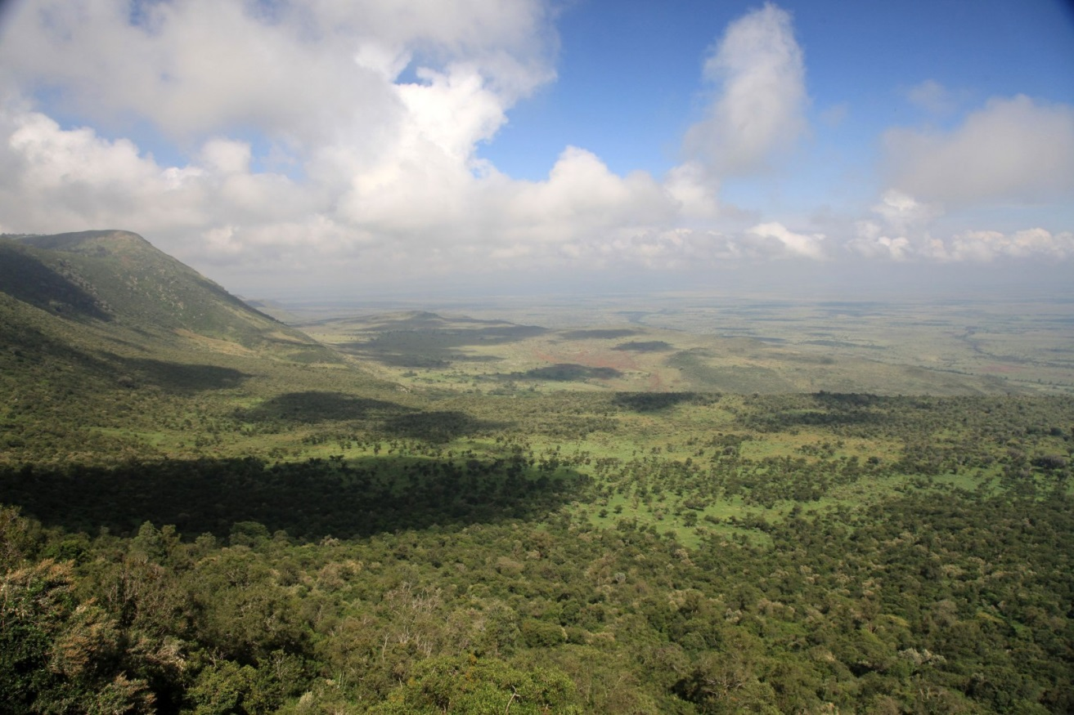

Slide 23
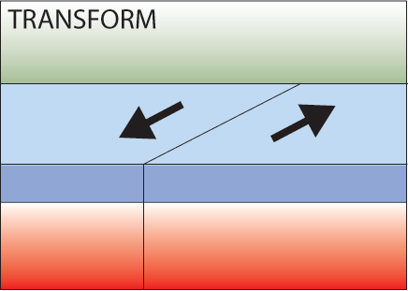
Transform Boundaries
Boundary between 2 plates that are sliding past one another

Slide 24
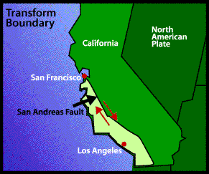
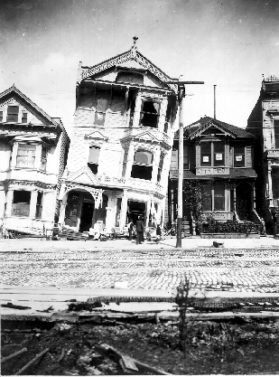
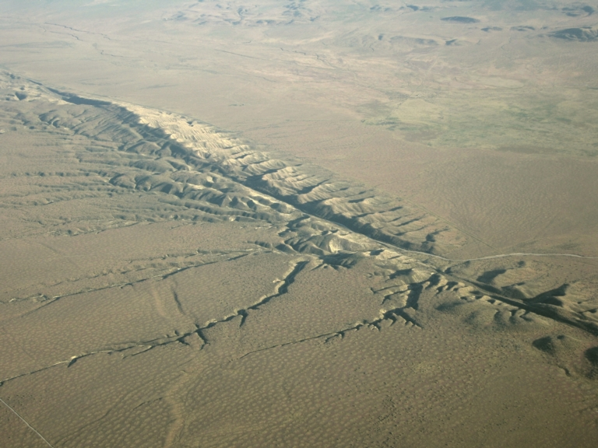
Transform boundary: San Andreas Fault

Slide 25
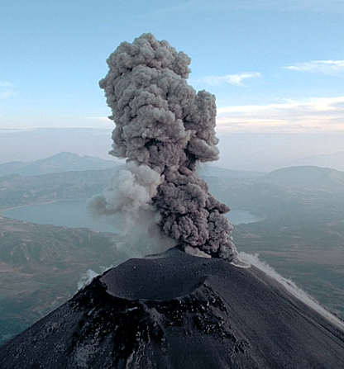
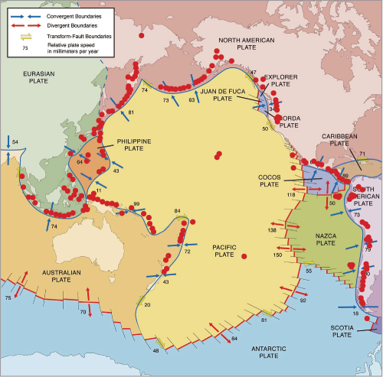
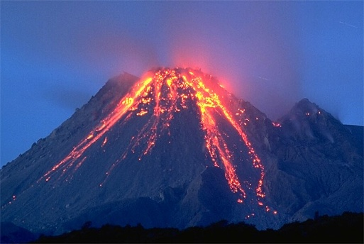
Pacific Ring of Fire
Area of the Pacific ocean where a large number of earthquakes and volcanic eruptions occur

Slide 26
Earthquake Patterns

