Slide 1
Language of Geography
Continents, Oceans, Hemispheres, latitude/longitude

Slide 2
Continents
Continent – very large landmass, 7 on Earth
North America
South America
Europe
Africa
Asia
Australia
Antarctica
Subcontinent – a large, relatively self-contained landmass forming a subdivision of a continent; ex. India

Slide 3
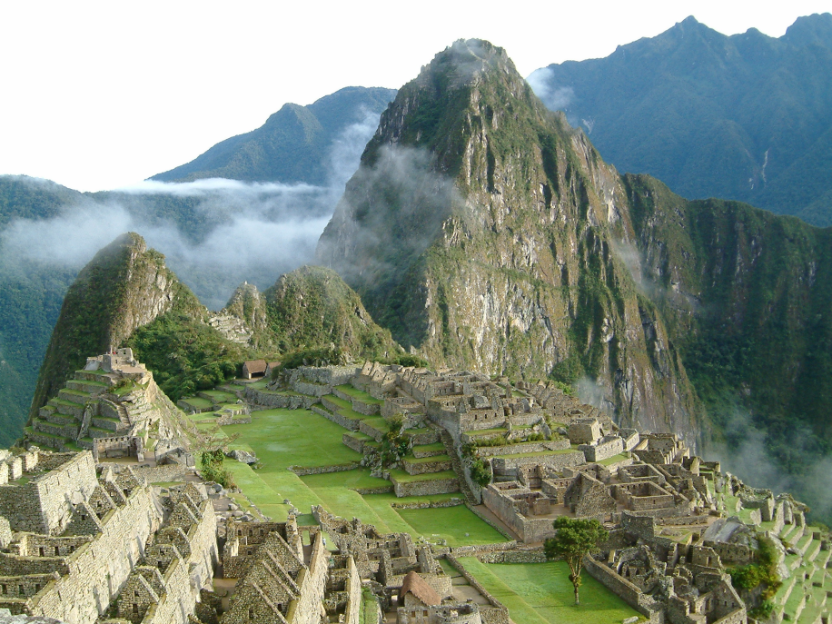
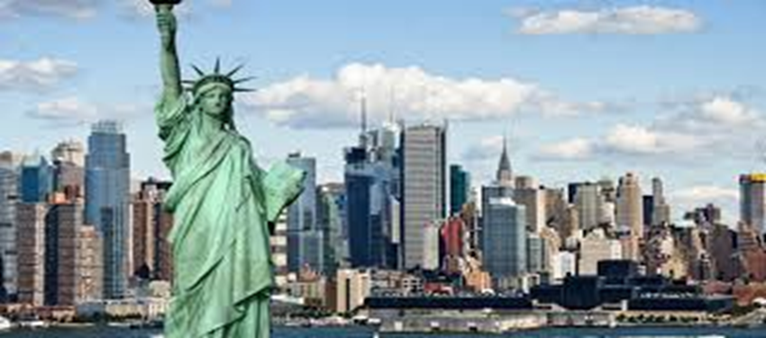
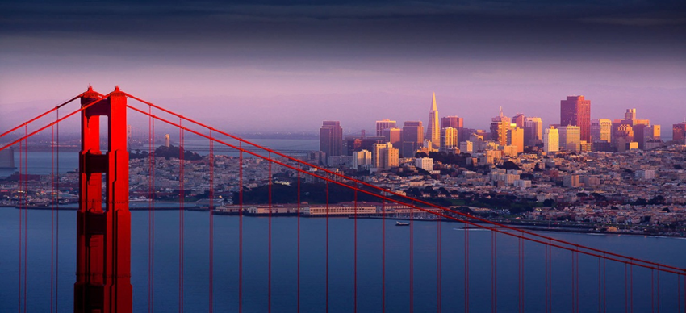
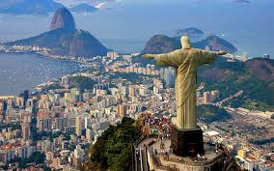
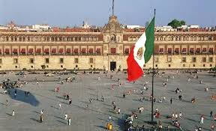
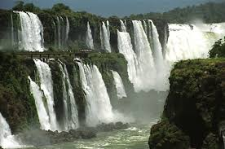
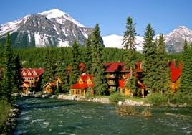

Slide 4
North America & South America
Only continents in the Western Hemisphere
Share similar colonial histories
North America – from Canada all the way down to Panama, including Greenland and the Caribbean
South America – from Colombia all the way to Tierra del Fuego, the tip of Chile and Argentina
World largest rainforest in South America – Amazon
World’s driest desert in South America – Atacama

Slide 5
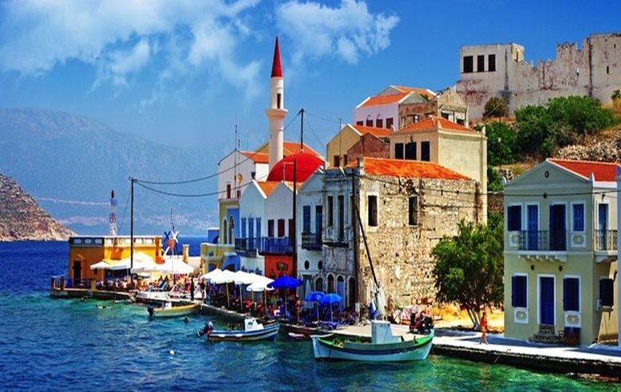
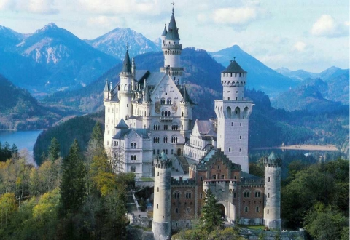
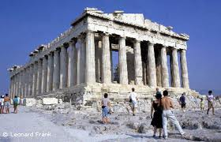
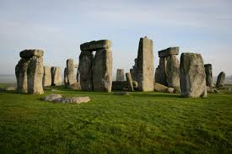
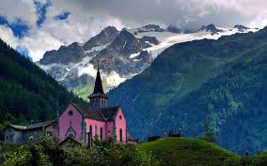
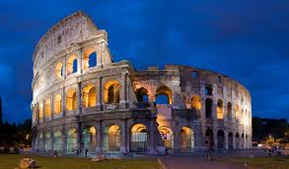

Slide 6
Europe
“peninsula of peninsulas”
Shares landmass with Asia, making up “Eurasia”
Russia is part of both Europe and Asia, split by the Ural Mountains
Lots of ethnic, cultural, and language diversity

Slide 7
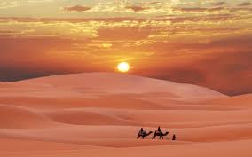
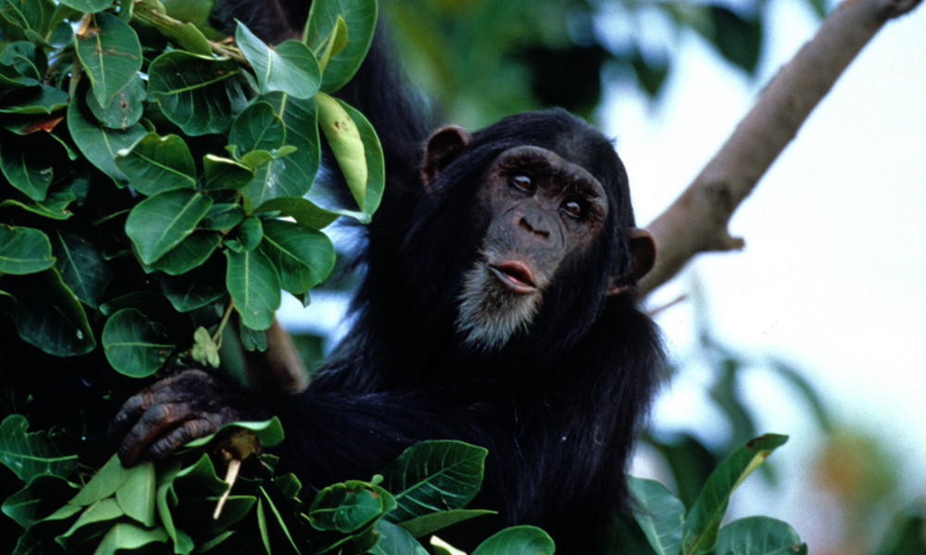
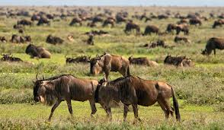
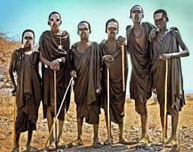
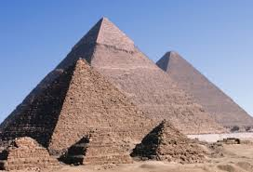
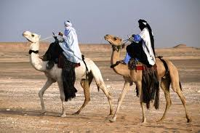

Slide 8
Africa
Has the world’s:
Largest non-polar desert – Sahara
Longest river – Nile
Second largest rainforest – Congo
Continent with most linguistic diversity
Long and harsh history of colonialization and civil wars

Slide 9
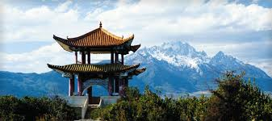
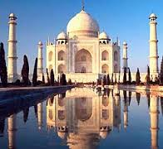
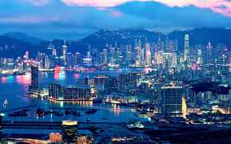
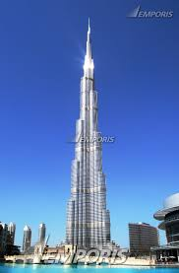
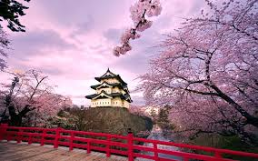

Slide 10
Asia
Largest continent of all
Includes the two most populous countries in the world – China and India
Spans many cultural regions, including the Middle East and India

Slide 11
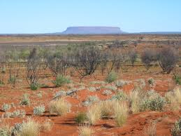
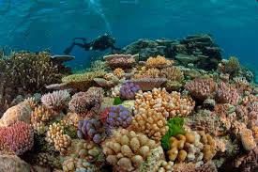
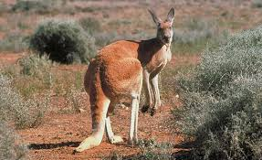
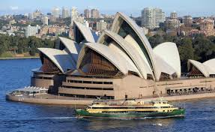

Slide 12
Australia
Continent and a country
Only continent that lies totally below the equator – “Land Down Under”
Large part of it is desert – Outback
Former British colony

Slide 13
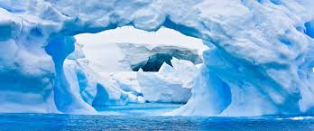
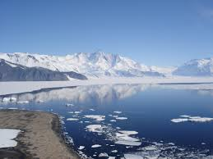
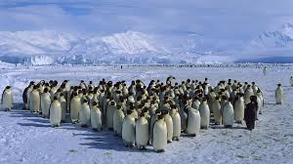
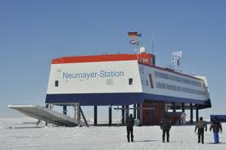

Slide 14
Antarctica
Is the world’s largest desert (what?!)
Desert - barren area of land where little precipitation occurs and consequently living conditions are hostile for plant and animal life
Has no permanent settlements or residents

Slide 15
Oceans
Only one global ocean, but divided into 5 different regions
Arctic – north polar region
Pacific – between the Americas & Asia
Atlantic – between the Americas & Africa
Indian – between Africa & SE Asia/Australia
Southern – from Antarctic coast to 60˚S
Pacific & Atlantic ocean are divided into North and South because of their size

Slide 17
Hemispheres
“Halves of Earth” – there are 4 Hemispheres
Referred to as : Northern, Southern, Eastern, and Western hemispheres
The EQUATOR divides the Earth into Northern and Southern hemispheres
The PRIME MERIDIAN divides Earth into Eastern and Western hemispheres

Slide 18
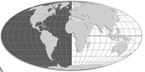
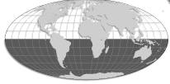
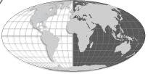
Northern
Western
Eastern
Southern

Slide 19
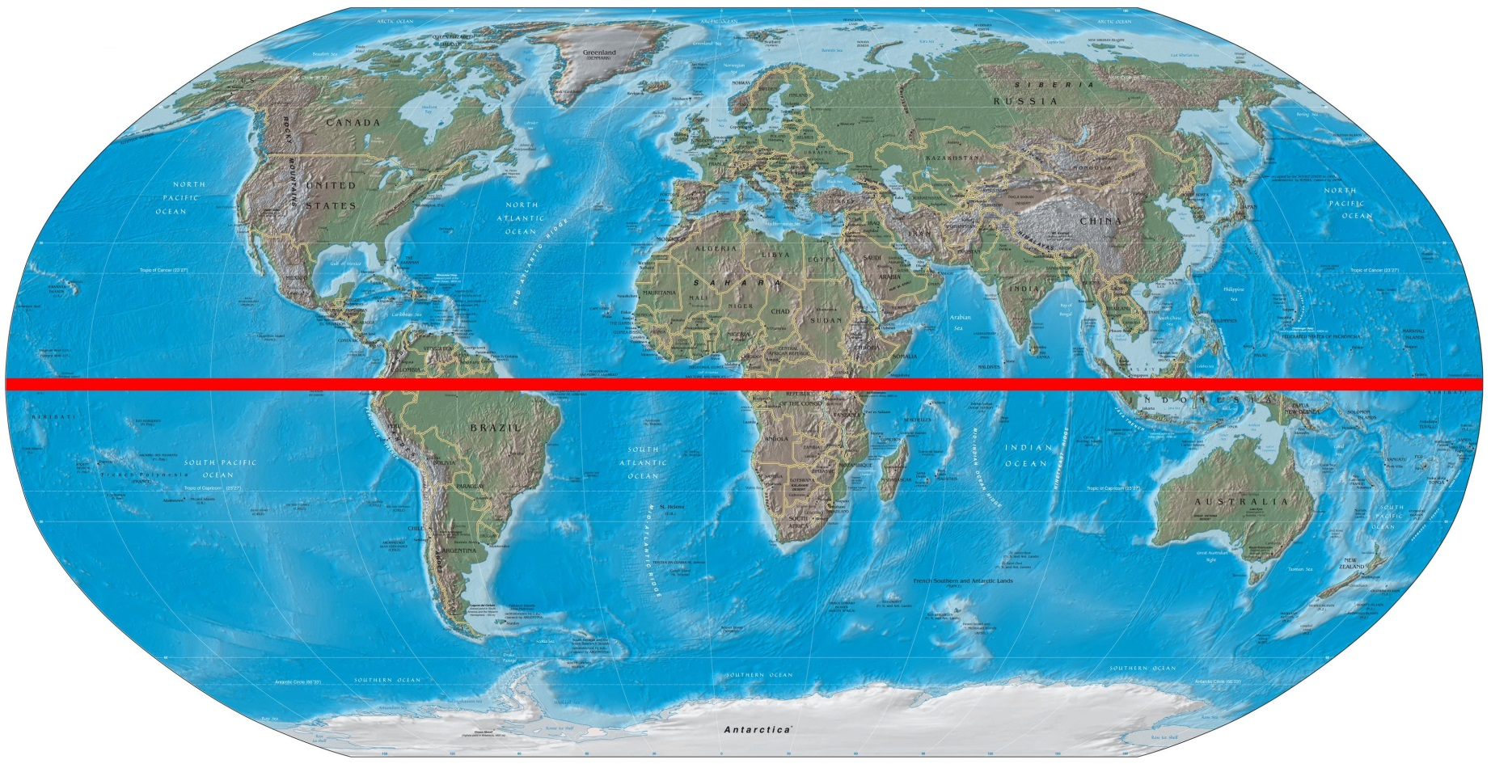
Equator

Slide 20
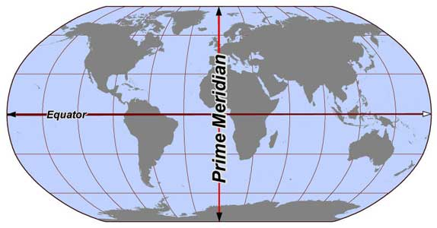
Prime Meridian

Slide 21
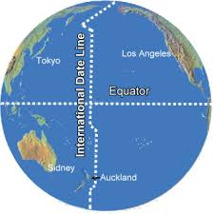
International Date Line
Lies on the opposite side of the Prime Meridian
Runs through the
middle of the
Pacific Ocean at 180°
Used to calculate
time zones

Slide 22
Tropics
Refers to a region of Earth surrounding the Equator; area that gets the most direct sunlight
Represented by lines of latitude
Tropic of Cancer – northern hemisphere at 23.5°N
Tropic of Capricorn – southern hemisphere at 23.5°S
Degrees correspond to the axial tilt of the Earth
More on this when we cover “seasons”!

Slide 23
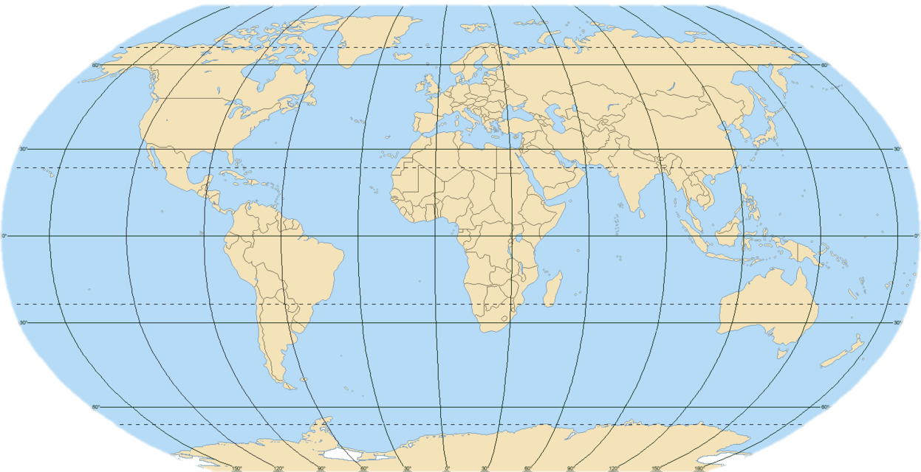
Latitude & Longitude
In order to better pin-point the many places on Earth a grid is used
The lines on the grid are referred to as: latitude and longitude

Slide 24
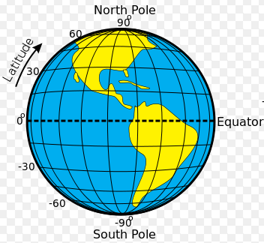
Latitude
Horizontal lines that run parallel around the Earth, meaning they never touch
Run left and right, but measure
North and South of the equator
Lat = flat
Measure between 0˚-90˚ N/S
Equator is the most important line of latitude
Equator = 0˚
Also called “parallels”

Slide 25
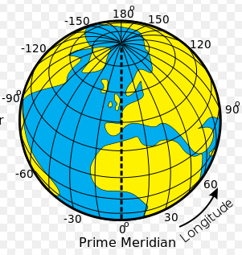
Longitude
Vertical lines on the globe, they converge (meet) at the poles
Run up and down the globe, but measure East & West of the Prime Meridian
Measure between 0˚-180˚ E/W
Prime meridian is the most important line of longitude
Prime meridian = 0˚
Also called “meridians”

