Slide 1
Geography
Introduction and the 5 Themes

Slide 2
What is Geography?
Greek origin…
Geo = Earth Graphy = Describe

Slide 3
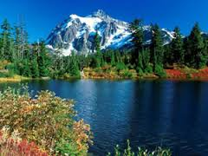
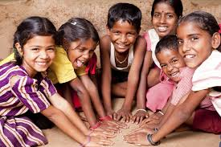
Geography is…
the study of Earth’s landscapes, people, places, and environments.
simply, about the world in which we live.

Slide 4
Branches of Geography
Physical Geography – looks at Earth’s natural environments and focuses on the 4 spheres.
Ex. Oceanography, climatology, meteorology, environmental mgt., geomorphology

Slide 5
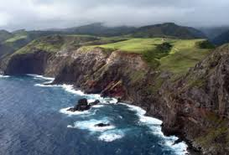
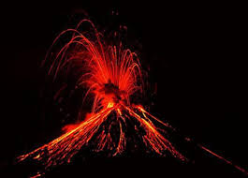
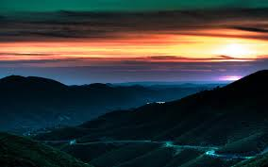

Slide 6
Branches of Geography cont.
Human Geography – looks at the characteristics and patterns of the world’s people and the processes that shape them.
Ex. Cultural geography, economic geography, medical geography, urban geography

Slide 7
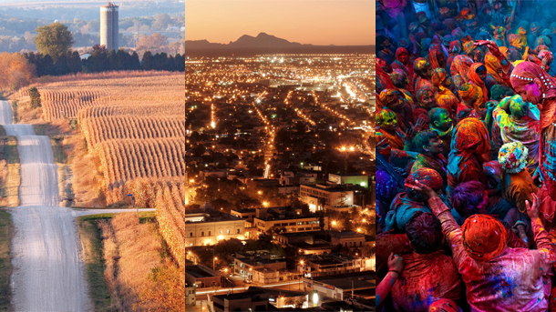

Slide 8
Branches of Geography
Regional Geography – focuses on regions of all sizes across the Earth.
Ex. Urban geography
GIS (Geographic Information Science) – deals with the digital storage of information about the Earth’s surface
related – cartography (map making)

Slide 9
5 Themes of Geography
Each theme answers a question. The themes are all connected and can’t be understood without one another.
1. Location – Where is it located?
refers to the absolute or relative spot of something on Earth.
Absolute location – tells exactly where something is located
Ex. Coordinates, an address
Relative location – tells location based on other places
Ex. “in the Alamo Ranch shopping center,” “across the street from”
Notes:
Examples using Taft as a location

Slide 10
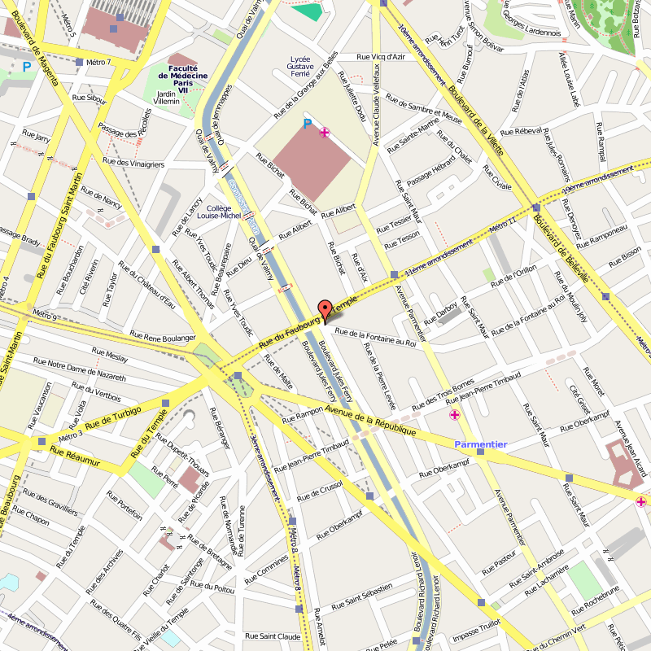

Slide 11
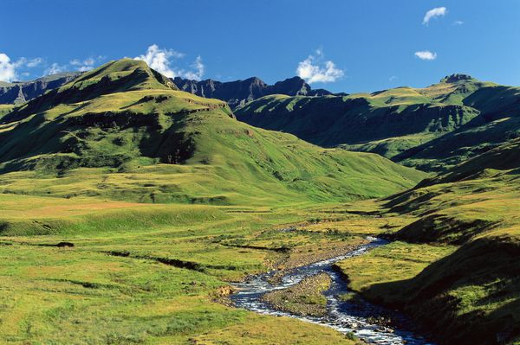
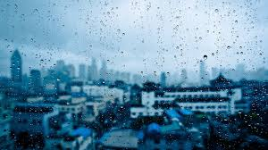
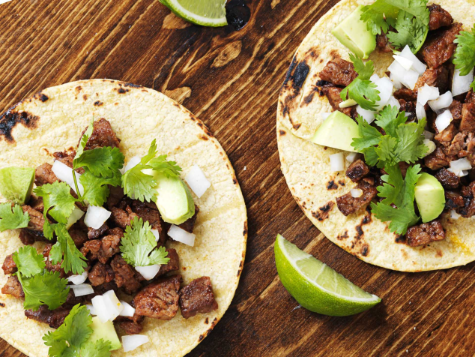
5 Themes of Geography
2. Place – What’s it like there?
Refers to the physical and human features of a place; what makes it different from other places

Slide 12
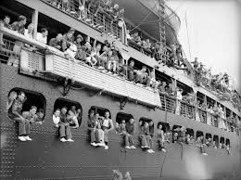
5 Themes of Geography
3. Movement – How and why are places connected with one another?
Refers to humans interacting on the Earth
Movement of people, goods, and ideas

Slide 13
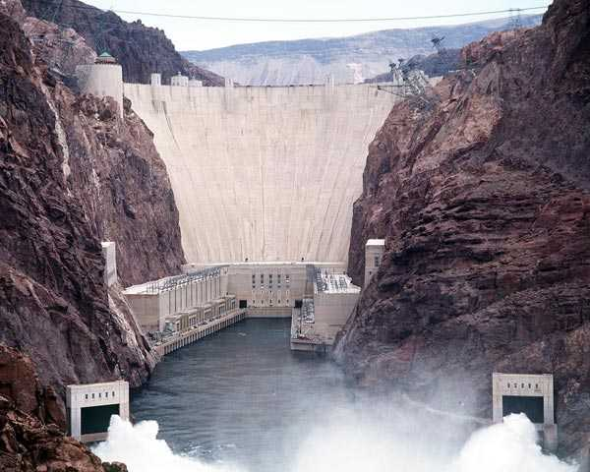
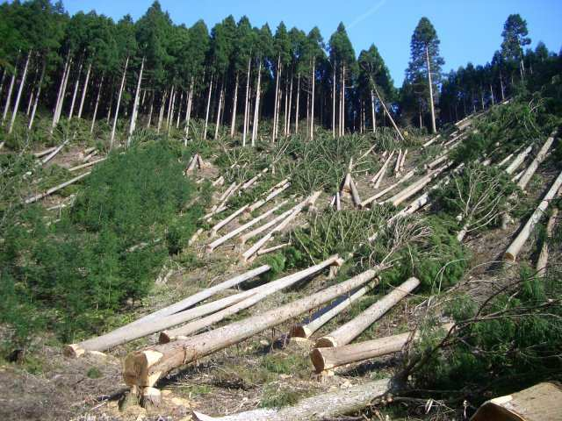
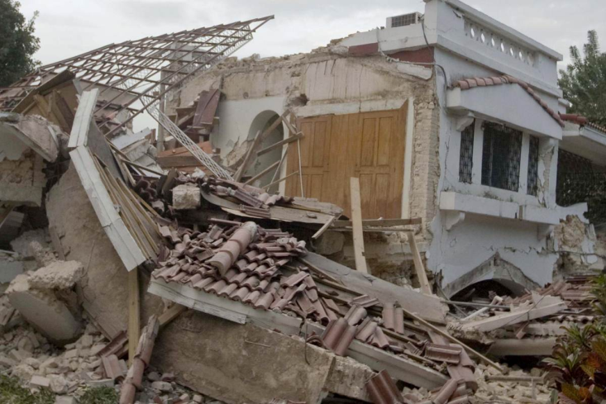
5 Themes of Geography
4. Human-Environment Interaction – What is the relationship between humans and their environment?
Refers to how humans depend, modify, and adapt to their environment

Slide 14
5 Themes of Geography
5. Regions – How and why is one area similar to another?
Refers to areas with similar features
Types of Regions
Formal
Functional
Perceptual

Slide 15
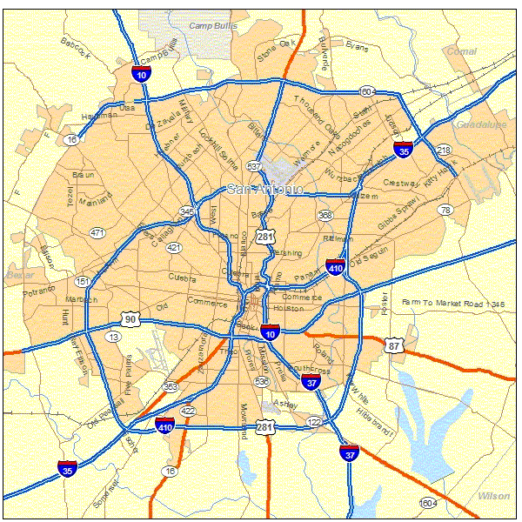
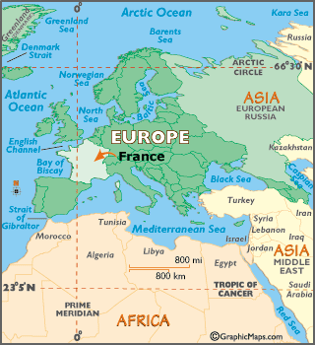
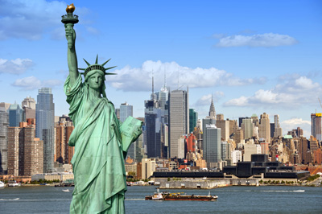
Formal Region
Defined by official boundaries.

Slide 16
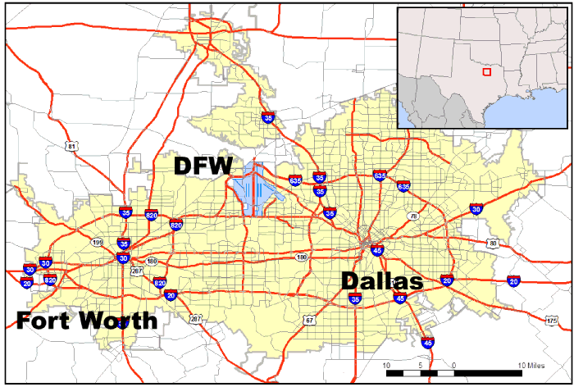
Functional Region
Made up of places that are linked and act as a unit; defined by their connections

Slide 17
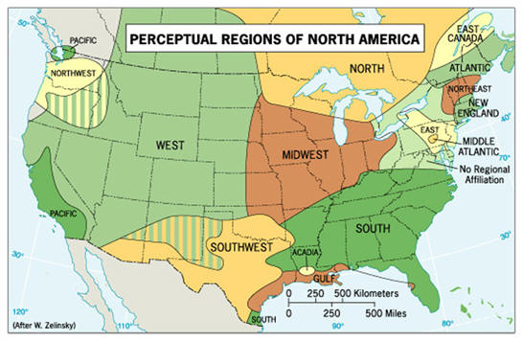
Perceptual Region
Reflects human feelings and attitudes, no formal boundaries

Slide 18
Think! How can San Antonio be divided up into regions?

