Slide 1
Interactive Notebook
Set up & note taking strategies

Slide 2
Purpose
The purpose of the interactive notebook is to produce a product that will reflect all of the material learned throughout the year.
It will be an excellent study tool for quizzes, tests, benchmarks, and finals.
It will teach you organizational and neatness skills.
It will serve as quick reference material for classwork.
Notebook checks are counted as test grades and should be boosts for your grade.

Slide 3
NEATNESS AND ORGANIZATION ARE KEY TO A PERFECT NOTEBOOK

Slide 4
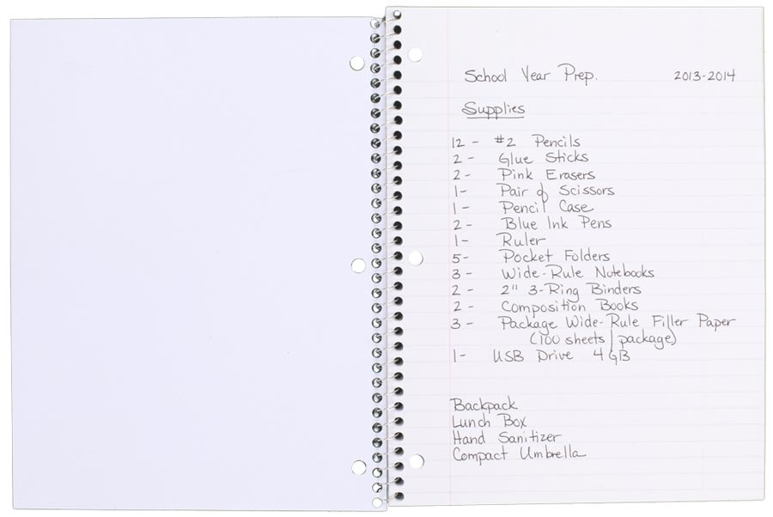
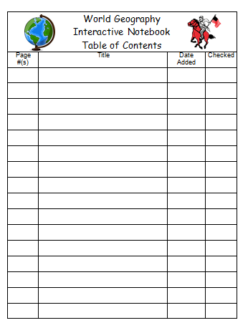
Set Up
On the inside cover of your notebook…
Tape one of these…

Slide 5
At the top right hand corner of the first page put a large number 1

Slide 6
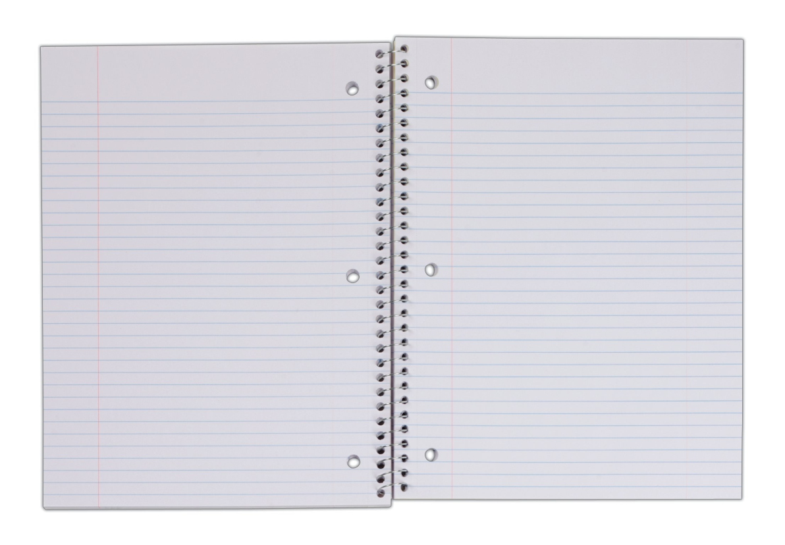
Flip the page and on the top left corner put a number 2. On the top right corner of the opposite page put a number 3.
Now go through the rest of the notebook
numbering on the outer top corners.
Even #s on the left…
…Odd #s on the right

Slide 7
Syllabus
On page 1 – turn our notebook horizontal and glue in your mini copy of the syllabus
This is here – front and center – in case you ever need a refresher on class policies and guidelines. You can refer to it throughout the year whenever you have a doubt or question.

Slide 8
Proper Note-Taking and Note-Taking Skills
Let’s practice!
Use pages 2-3 to take the following notes.

Slide 9
Proper Note-Taking
In order to be useful, notes must be written neatly and kept organized
writing must be legible
writing must not be cluttered
notes should be in the order that they were taken - don’t skip around
notes should be have titles, and be labeled with dates
Pay attention to titles, headings, and subheadings. These should be the words that stand out the most on your paper.

Slide 10
Proper Note-Taking
Use bullet points, sub bullet points, and hyphens as well as indentions to organize notes
Use a new line for each bullet point
Sub pullet points should be indented
Use clouds, boxing, underlining, highlighting, to emphasize important points
Notes should have a flow to them, they should not look like an essay.
Headings should be obvious. This makes reviewing, as well as finding answers easier.

Slide 11
Note-Taking Skills
Ways you can make headings stand out:
use a different color ink Heading
Highlight
underline Heading
draw a box around them
draw a symbol next to them Heading
Write quickly, but efficiently
abbreviate what you can. Ex. Government = govt
use acronyms for commonly used terms. Ex. Total fertility rate = TFR
Heading
Heading

Slide 12
Note-Taking Skills
Listen actively, even while you are writing
Remember that not ONLY what is on the screen is important. Pay special attention to things that the teacher repeats and/or puts emphasis on. Those things should be part of your notes as well.
Remember that you do not absolutely have to write down everything that you see on the screen. Notes should be detailed, but that can be achieved without writing down every.single.word. Paraphrase!

Slide 13
Put them to work!
Revisit and review – often!
First 5 minutes of class (warm-ups)
is an excellent time to review your notes.

