Slide 1
Economic Systems
Chapter 17

Slide 2
Main Idea
Economies vary when it comes to government involvement. The relationship between government and the economy has been debated since America’s historical beginnings.

Slide 3
Understanding Economic Systems
Economics is the social science that analyzes the production, distribution, and consumption of goods and services
An economic system is the method used by a society to produce and distribute goods and services.
Each system answers the 3
fundamental economic questions
Level of government involvement
varies across systems

Slide 4
Fundamental Economic Questions
What should be produced?
2. How should it be produced?
3. Who should get it?
Each economic systems answers these questions in a different way.

Slide 5
Problem of Scarcity
The basic problem of economics is the problem of scarcity
The idea that humans have unlimited wants, but only limited resources to satisfy those wants

Slide 6
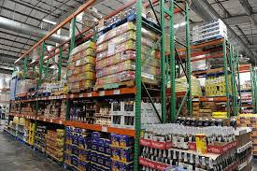
Economic Vocabulary
Goods – things that people make
Clothes, food, cars, furniture, etc.
Services – things that people do for others in exchange for money
Electricians, plumbers, hairdressers, doctors, etc.

Slide 7
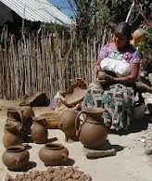
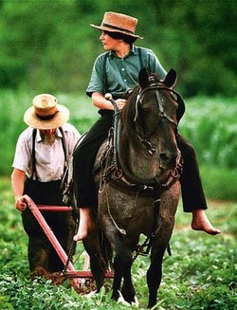
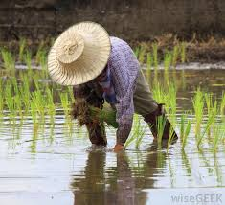
Traditional Economy
Economic questions are answered by customs and traditions – the way it has always been done
Children work the same jobs parents worked
No private property – everything is communally owned

Slide 8
Traditional Economy
Characterized by cottage industries and subsistence agriculture
Cottage industries – production of goods that meet the needs of the family or village. Ex. Furniture, clothes
Subsistence agriculture – type of agriculture in which farmers grow crops or raise livestock for personal consumption, not sale
Very little to no trade
Economic growth is slow
Found in rural, non-industrial areas of the world
Ex. Inuit, Amish, Pigmies, Bushmen

Slide 9
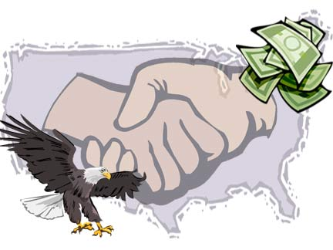
Free Enterprise System
An economic system in which factories, equipment, or other means of production are privately owned rather than controlled by the government
Government plays a limited role - acts as an umpire, sets and enforces the rules, protects people’s rights, etc.
Also known as capitalism
or the free market economy

Slide 10
Free Enterprise System
Individuals have the right to own private property
Right to buy or sell any legal goods, and take part in a legal business, big or small.
Economic questions are answered by individual buyers and sellers
Prices are determined by the interaction between supply and demand
Supply – the amount of a product or service that is available to consumers
Demand – how much of a good consumers want and are willing to buy at a certain price

Slide 11
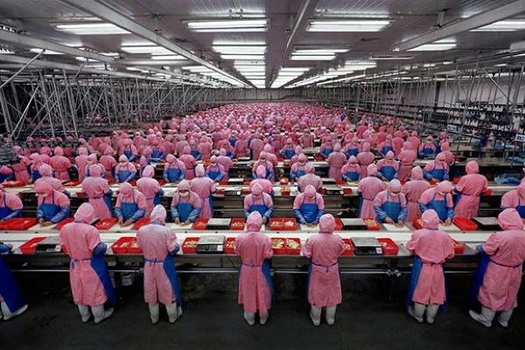
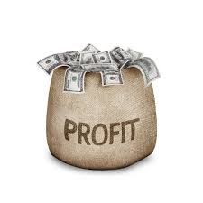
Free Enterprise System
Characterized by commercial agriculture and industries
Commercial agriculture – crops are mass produced and intended for sale
Commercial industries – goods are mass produced and intended for sale
Profit motive – people act out of self interest; desire for profit drives the economy
Competition amongst businesses
Examples: United States, France, Japan

Slide 12
Supply and Demand
Law of supply says that suppliers are more willing to provide goods and services when they are able to charge a higher price
Law of demand says that consumers are more willing to buy goods and services at lower prices
The free enterprise system is
based upon finding a price where
the quantity supplied is equal to the
quantity demanded. This is
known as market equilibrium.

Slide 13
Supply & Demand Scenarios
Supply | Price
Demand | Price

Slide 14
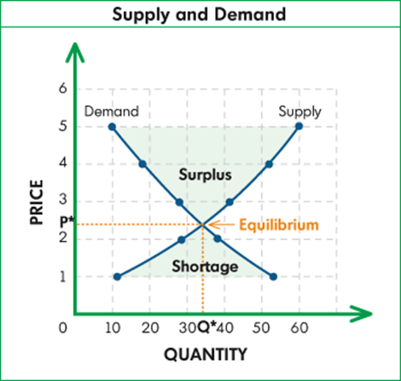

Slide 16
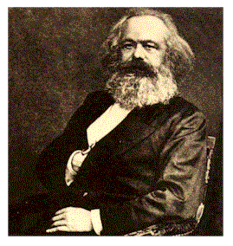
Communism
An economic system in which the state or the community owns all property and the means of production, and all citizens share the wealth.
Government answers all basic economic questions
Developed by German sociologist/philosopher Karl Marx.
Main goal is for everyone to be equal – no social classes
Cooperation replaces competition

Slide 17
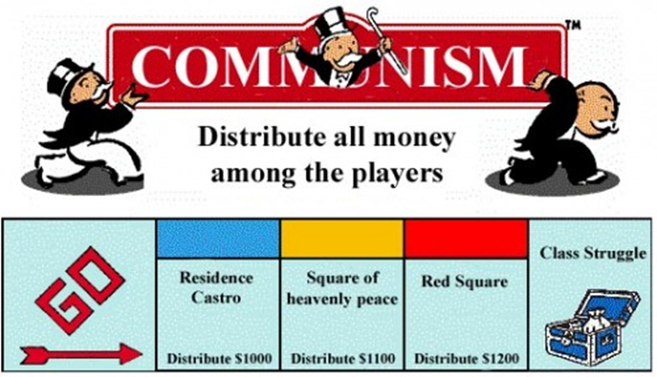
Communism
Usually found in dictatorial and totalitarian governments
Advantages: able to act quickly in emergencies, provide for all people equally
Disadvantages: Inefficient, no incentive to work hard or be creative – profit motive is lost, widespread corruption
Examples: China, Cuba,
former Soviet Union,
North Korea

Slide 18
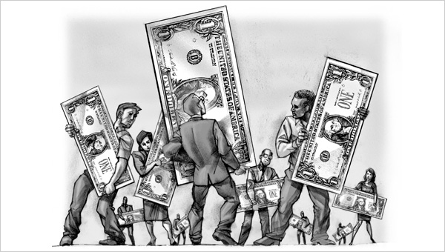
Socialism
Economic system in which the government owns all or most major industries, such as: transportation, health care, banks, utilities, mining or oil companies
Encourages private ownership of small businesses
Main goal is a fairer distribution of income
Examples: Israel, Sweden, Canada, Denmark

Slide 19
Socialism
Socialist countries enjoy high standards of living
Pro: Focuses on the greater benefit to society
Con: Does so at the expense of higher taxes

Slide 20
Mixed Economies
In reality...no modern economy follows any one economic system
Most countries have a blend of all of them
Countries can be classified on a spectrum ranging from free enterprise to communist based on government involvement.
United States has many features of a capitalist economy, but also blends some socialist aspects

Slide 21
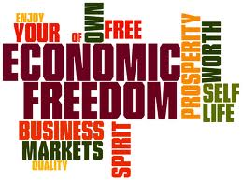
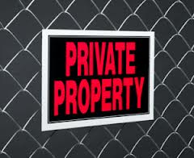
Features of American Free Market Economy
Economic Freedom: individuals have the right to choose
Competition: more than one producer of good/services insures choice
Private Property: individuals have the right to own their own property, including business

Slide 22
Self-Interest: individuals make
decisions based on what is best for them
Voluntary Exchange: individuals may freely buy and sell goods
Profit Motive: individuals are driven by a desire to profit (make money)

Slide 23
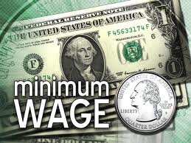
Features of American Socialist Economy
Government regulation of some business practices
Ex. Wages, labor hours,
safety practice
Government limits certain choices
Ex. Cannot buy or produce certain goods/services
Government provides aid to the needy
Ex. Medicare, Medicaid, welfare

