Slide 1
Economic Development

Slide 2
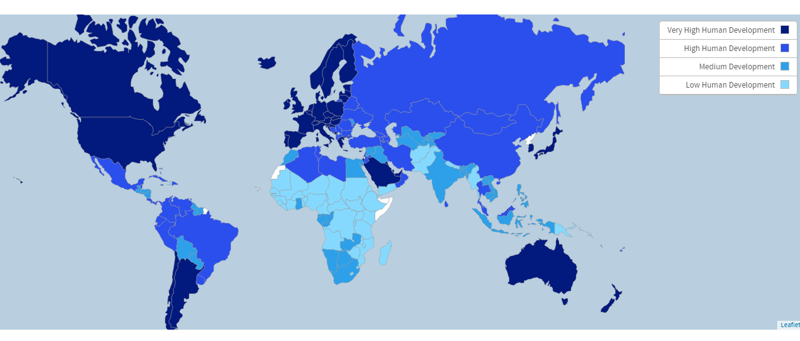

Slide 3
Economic Development
Refers to how advanced an economy is
Countries are ranked on a spectrum, in terms of development
Industrialized or more developed countries have advanced economies and higher standards of living
First World, highly developed, developed, MDCs
Less developed countries have less advanced economies and lower standards of living
Third World, underdeveloped, LDCs
Countries in the middle of this spectrum are considered “emerging economies” or “newly industrialized nations”
developing

Slide 4
Indicators of Development
The Human Development Index was developed by the United Nations as a tool to rank countries based on level of economic development
Considers demographic, economic, social, and political indicators

Slide 5
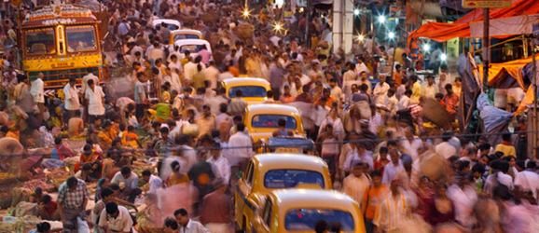
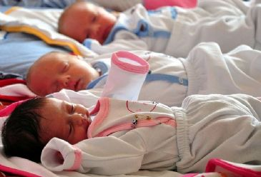
Demographic Indicators
Relate to aspects of the population
Looks at things such as…
Life expectancy
Birth and death rates
Total fertility rates
Infant mortality rates
% of urban pop.

Slide 6
Economic Indicators
Show how well an economy is performing
Looks at things such as…
Gross Domestic Product - the total value of all goods and services produced by a nation in a year within its borders
Gross National Product – includes GDP + goods and services produced outside of the country’s borders by its citizens
Gross National Income – summed up as the total income generated by a country in a given year
GNI per capita – “per person”, GNI divided by total pop.; reflects average income of a country’s citizens

Slide 7
Economic Indicators
May also look at things such as, unemployment rates, foreign investment, remittances, etc.
Remittances - a transfer of money by a foreign worker to an individual in his or her home country
In LDCs remittances make up a larger % of the GNI

Slide 8
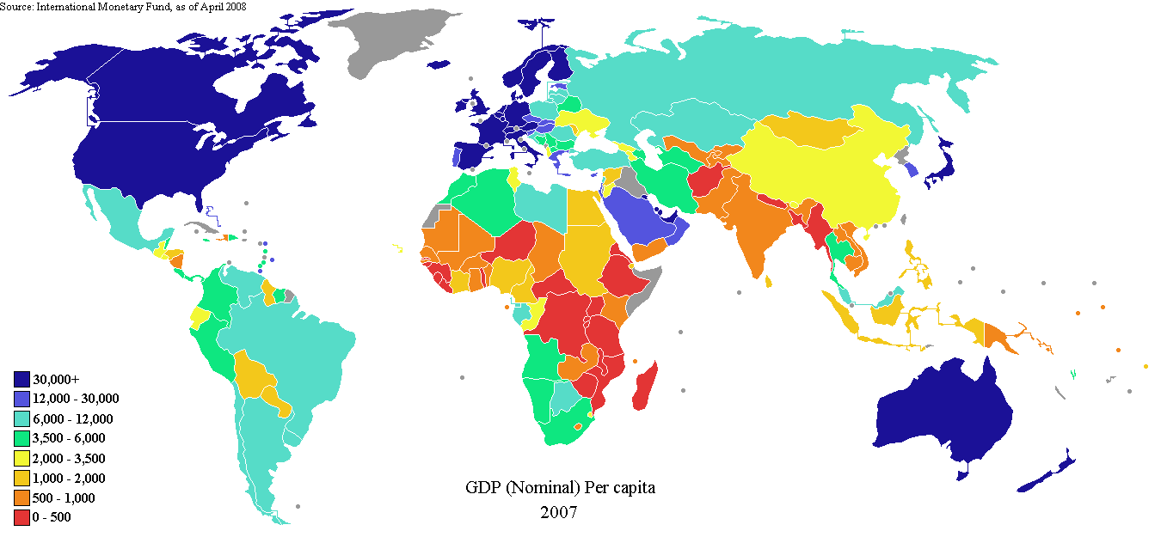

Slide 9
Social Indicators
Measure social aspects of a country’s population such as…
Literacy Rates
% of people over age 15 who can read and write
% of people attending places of higher education
Expected years of schooling
Number of professional people (doctors, lawyers, etc).
Housing availability
Access to clean water
Sanitation systems
% of pop. with access to internet
Cell phone subscriptions

Slide 10
The phenomenon of “Brain Drain”
Many LDCs lack quality education facilities, therefore, individuals who have the potential to become highly skilled, cannot do so in their home country. Instead, they emigrate to MDCs where they can have access to said education/training.
Upon gaining education/training, individuals stay in the MDC for employment, depriving their home country of their services
Keeps LDCs struggling for innovation and investment

Slide 11
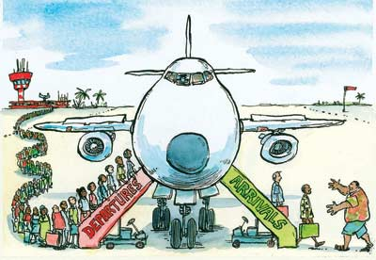

Slide 12
Political Indicators
Speak to a country’s government and gov’t involvement
Look at things such as….
Degree of democracy and voting rights
Level of human rights
Degree of government opposition
Tolerance for different points of view
Income gender inequalities

Slide 13
Government Relation
There is NOT a direct relationship between economic development and a nation’s system of government.
A nation’s economic system could help transform its political system.

Slide 14
The Role of Physical Geography
Physical geography can and most definitely affects the development of a country
Landlocked countries tend to have a lower level of development – access to resources
Larger countries may have many more natural resources
Countries with rough terrain (mountains, deserts, etc.) may have a harder time developing
The role of climate
Countries in the mid-latitudes tend to have higher levels of development and be more economically productive
Countries in the low-latitudes have lower levels of development

Slide 15
Economic Activities
A nation’s level of economic development is closely tied to the types of economic activities occurring.
More advanced economic activities = more advanced economic development
There are 4 tiers of activities

Slide 16
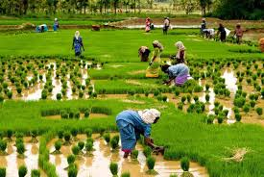
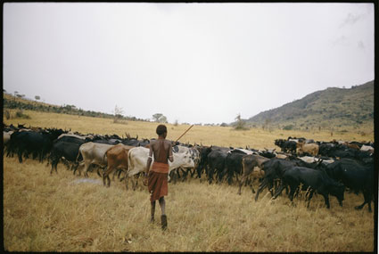
Primary Activities
Involve the production of foods and the extraction of natural resources
Agriculture, mining, logging, fishing, etc.
Require little skills/education
Primarily associated with LDCs

Slide 17
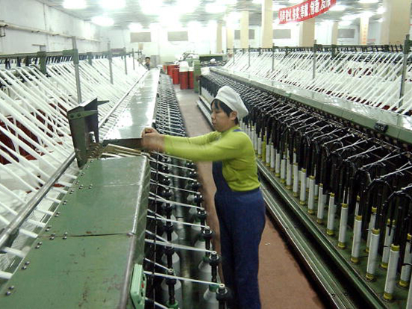
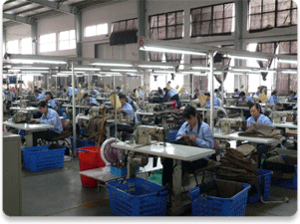
Secondary Activities
Focus on manufacturing and production of goods, such as the making of textiles, furniture, cars, etc.
Primarily associated with newly industrialized nations

Slide 18
Tertiary Activities
Deal with services
Identified by a variety of services performed by people and businesses
Many require a high skill set and/or advanced education
Associated with developing/MDCs

Slide 19
Quaternary Activities
Consist of those involving information processing and management
Require advanced degrees/licenses/certificates
Primarily associated with MDCs

Slide 20
Summary
By and large, the bulk of the world’s LDCs are found in Central Africa.
Location in the mid-latitudes is a disadvantage, history of colonization
Other regions with some LDCs are Central America, Middle East, and Southeast Asia.
Development is hard to measure…some countries can be considered developed in economic terms, but not in social terms, and vice versa

