Slide 1
DEMOGRAPHY
HUMAN GEOGRAPHY

Slide 2
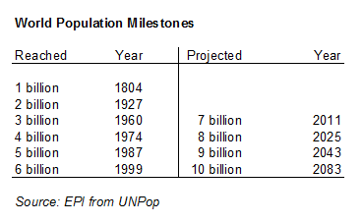

Slide 4
POPULATION
Earth’s population is 7 billion.
San Antonio’s population is 1.4 million.
Demography - study of human population and population patterns; population science
Population Density - # of people per square unit.
Sparsely populated - not crowded
Densely populated - very crowded

Slide 5
World Population Density

Slide 6
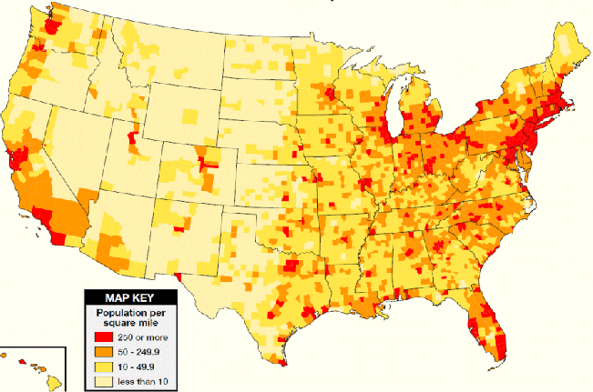
POPULATION DENSITY OF THE U.S.

Slide 7
Top 10 largest U.S. cities by population

Slide 8
Demographers look at…
Population Distribution - how population is spread out.
Uneven -
Population Changes
Historical events that result in drastic changes
Population Trends
Migration, etc.

Slide 10
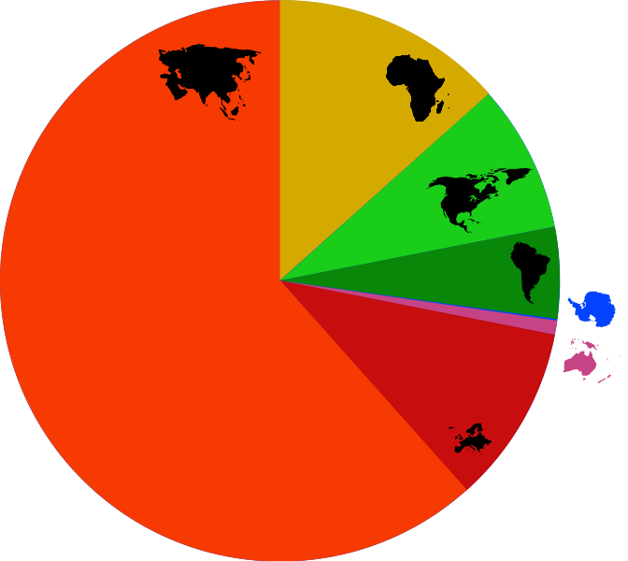
World Population by Continent

Slide 11
POPULATION FACTORS
Birth rate - # of births per 1000 people
Death rate - # of deaths per 1000 people.
Rate of natural increase – calculation of how population is growing; birth rate minus death rate
Total Fertility Rate – the average # of children born to a woman of childbearing age
Migration – people moving from one place to another.

Slide 12
POPULATION CHANGES
War, famine, disease are all population controls
Over 60 million deaths in WWII
Over 50 million deaths in Europe due to the Bubonic Plague
Over 1 million deaths in Ireland during the Potato Famine
Famine – extreme shortage or scarcity of food
Agriculture, medicine, technology all have helped population increase

Slide 13
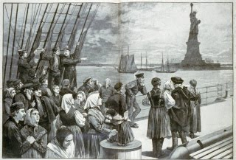
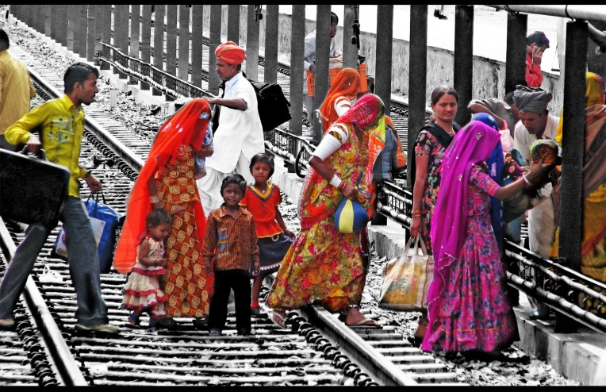
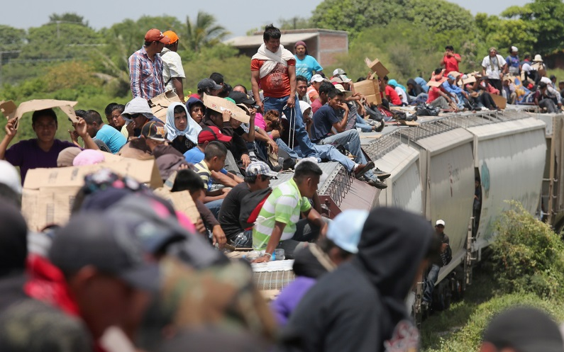
Population is also often affected by migration
EMIGRANTS - Leaving (exit)
IMMIGRANTS - Coming to a new place.
PUSH FACTORS - things that make you want to leave a place.
PULL FACTORS - things that make you want to move to a place.

Slide 14
WORLD BIRTH AND DEATH RATE INFORMATION
BIRTH RATES
DEATH RATES
20 births/1,000
128.9 ml. births per year
353,015 births per day
14,709 births per hour
245 births each minute
4 births each second of every day.
8 deaths/1,000
53.4 ml. deaths per year
146,357 deaths per day
6098 deaths per hour
102 deaths each minute
Almost 2 people die each second.

Slide 15
Population Factors for Select Countries
United States
Birth Rate – 13.42
Death Rate – 8.15
TFR – 2.01
RNI – 0.77%
Urban pop – 82.4%
Life Expectancy – 79.56
Mexico
Birth Rate – 19.02
Death Rate – 5.24
TFR – 2.29
RNI – 1.21%
Urban pop – 78.1%
Life Expectancy – 75.43
Haiti
Birth Rate – 22.83
Death Rate – 7.91
TFR – 2.79
RNI – 1.08%
Urban pop – 53.4%
Life Expectancy – 63.18
Sweden
Birth Rate – 11.92
Death Rate – 9.45
TFR – 1.88
RNI – 0.79%
Urban pop – 85.2%
Life Expectancy – 81.89

Slide 16
United States
Birth Rate – 13.42
Death Rate – 8.15
TFR – 2.01
RNI – 0.77%
Urban pop – 82.4%
Life Expectancy – 79.56
Nigeria
Birth Rate – 46.12
Death Rate – 12.73
TFR – 6.89
RNI – 3.28%
Urban pop – 17.8%
Life Expectancy – 54.74
China
Birth Rate – 12.17
Death Rate – 7.44
TFR – 1.55
RNI – 0.44%
Urban pop – 50.6%
Life Expectancy – 75.15
Zimbabwe
Birth Rate – 32.47
Death Rate – 10.62
TFR – 3.56
RNI – 4.36%
Urban pop – 38.6%
Life Expectancy – 55.68
Afghanistan
Birth Rate – 38.84
Death Rate – 14.12
TFR – 5.43
RNI – 2.29%
Urban pop – 23.5%
Life Expectancy – 50.49

Slide 17
POPULATION TRENDS
The world’s population is growing rapidly due to: better food, medicine and sanitation.

Slide 18
Global Population Distribution
Population Distribution of the Earth is uneven due to factors such as climate, landscape, transportation routes, and available resources.
There are FOUR centers of heavy population in the world
These areas contain more than 70% of the Earth’s population

Slide 19
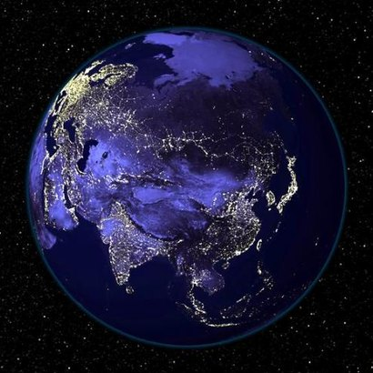
Eastern Asia has the greatest concentration of people on Earth – it is centered in China and has 21% of Earth’s population.
2) Southern Asia is the second largest concentration of
people – it is centered in India and has 16% of the Earth’s pop.

Slide 20
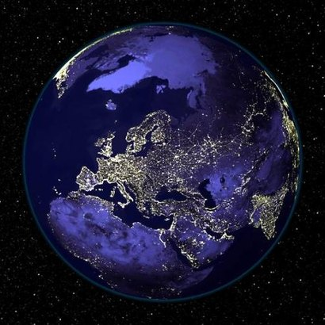
3) Western Europe is the third largest concentration.
In Western Europe people are concentrated near natural resources needed for industry.

Slide 21
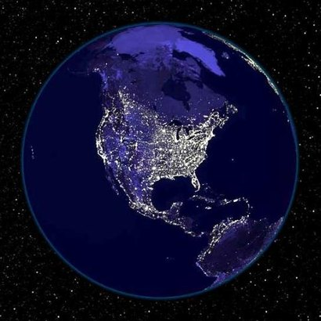
East Central North America is the fourth largest center concentrated in the NE US and SE Canada.
In the US, the chain of cities start from the city of Boston to south of Washington DC.
- This is called a megalopolis.

Slide 22
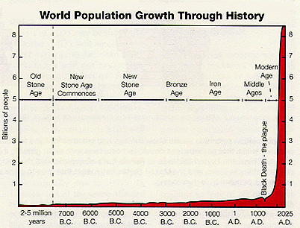
“The J Curve”
Notes:
What happened in the last 1000 years that enabled the population to grow so dramatically?
Agricultural Revolution – better food, knowledge of farming
Industrial Revolution – higher standard of living

Slide 24
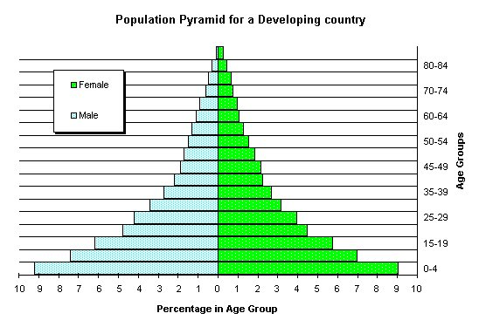
Population Pyramids
Graph that shows the percentage of population in certain age groups
Separates male and female
Allows you to make predictions

Slide 25
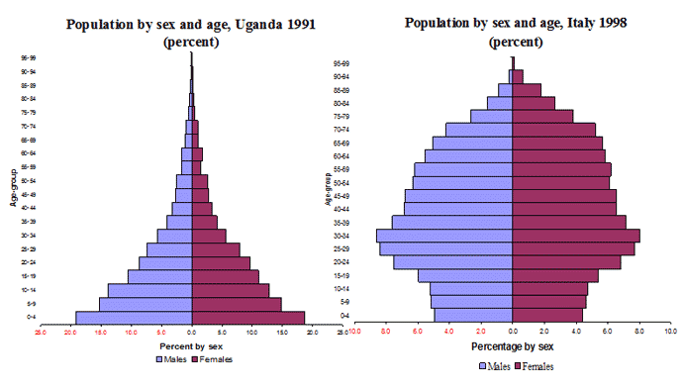
Which one of these countries will need more health care workers?
Which one of these countries will need more elementary schools?

Slide 26
Demographic Transition Model
Complex line graph that categorizes a country based on birth & death rate
Determines:
Growth
Standard of Living
Level of industrialization

Slide 27
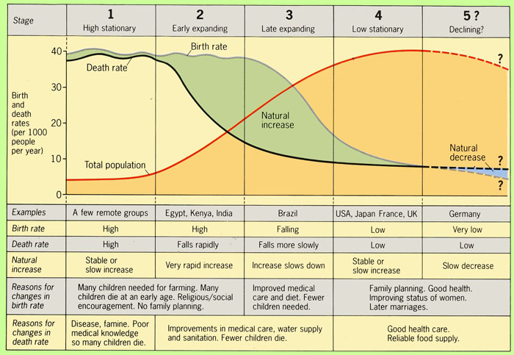
Demographic Transition Model

Slide 28
Stage One
High Birth Rate
High Death Rate
Result: slow growth rates
Pre-industrial, hunter/gatherer societies in remote areas
Not found in present day countries as a whole, but can be found in some isolated societies

Slide 29
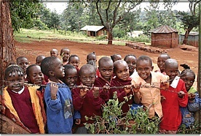
Stage Two
High Birth Rate
Low or Falling Death Rate
Result: Rapid Growth Rate
Very LOW Standard of Living
Found In Least Developed Countries
South America
Southern Africa
Asia

Slide 30
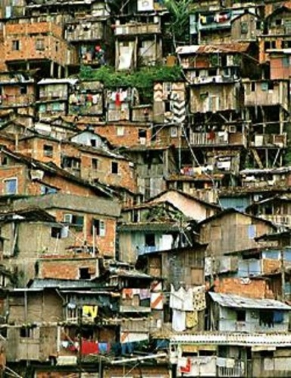
Stage Three
Moderate to High Birth Rate
Low Death Rate
Result: Explosive Growth Rates
Causes a large population increase, but standard of living remains low
Developing Countries and the Newly Industrialized Countries
Found In Countries:
Mexico
Southeast Asia
Middle East

Slide 31
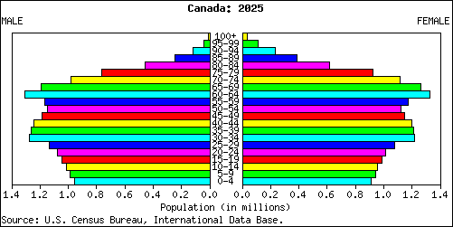
Stage Four
Low birth rates
Low death rates
Result: slow or no growth rates
Population slowly increases, with a high standard of living
Developed Countries
USA
Canada
Australia
Europe

Slide 32
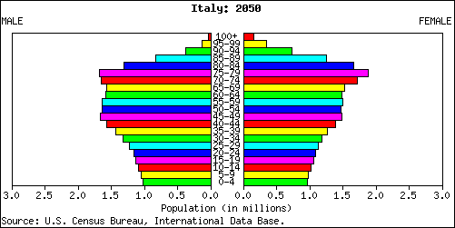
Stage Five
Negative Birth Rate
NEGATIVE or NO GROWTH
Low Death Rate
Result: No growth, even population loss
Population begins to shrink, usually has a high standard of living
Found In “Post-Developed” Countries
Germany
Sweden
Norway
Italy

