Slide 1
World Cultural Regions
North America

Slide 2
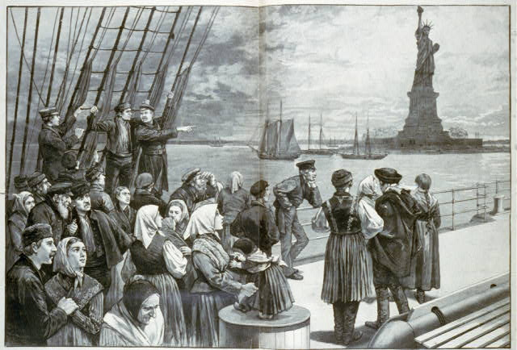
North America
Important countries
United States
Canada
Similar cultural characteristics
History of colonization
Diverse populations w/immigrant roots
History of religious freedom
Highly industrialized and technologically advanced

Slide 3
ESPN - Economic
Highly developed nations – high GDPs
Land use – farming, forestry, ranching
Most land in Canada is not usable
Resources – oil, natural gas, iron, coal, zinc
Part of NAFTA – trade organization
Canada is the United States’ biggest trading partner

Slide 4
ESPN - Social
History of colonization
British and Spanish in U.S.
French in Canada
Diverse populations – various languages & religions
English is dominant language
French is also official in Canada
“Non-traditional” family structures
High standards of living
High HDI ranks – U.S. 8th, Canada 9th
High literacy rates – 97%
82% of pop. lives in urban areas

Slide 5
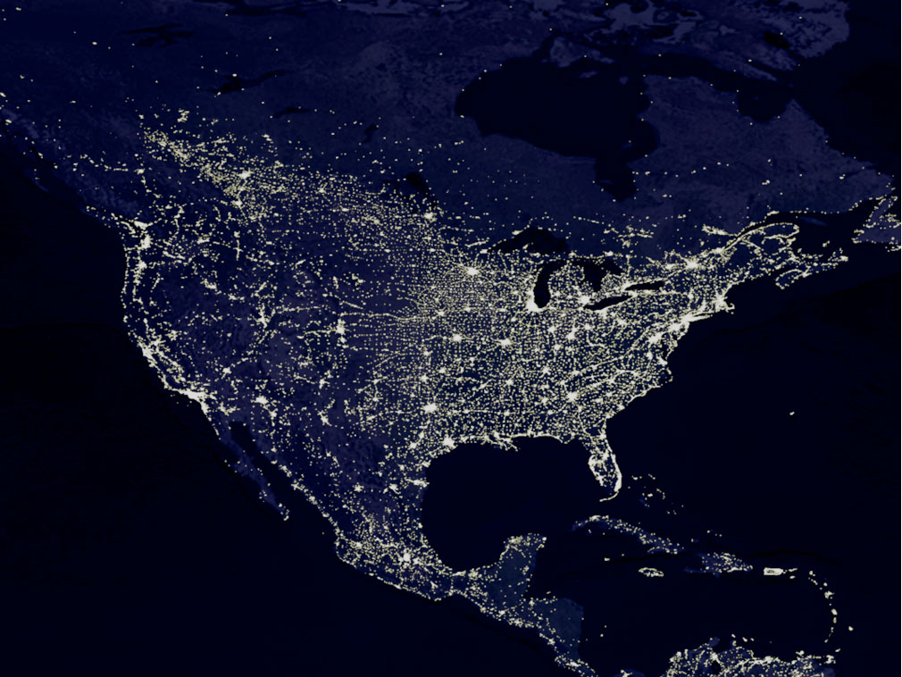

Slide 6
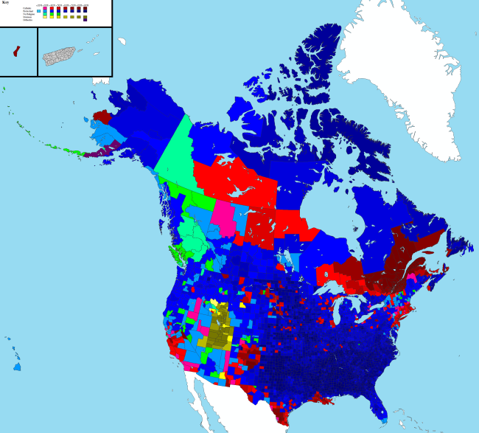
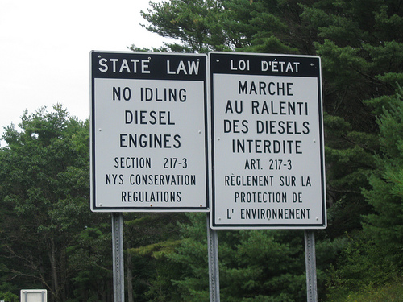

Slide 7
ESPN – Political
Democratically elected governments
Many laws left up to states/provinces
U.S. – divided into 50 states
Canada – divided into 10 provinces and 3 territories
Share the world’s largest unfortified border
Separatist issues in Quebec

Slide 8
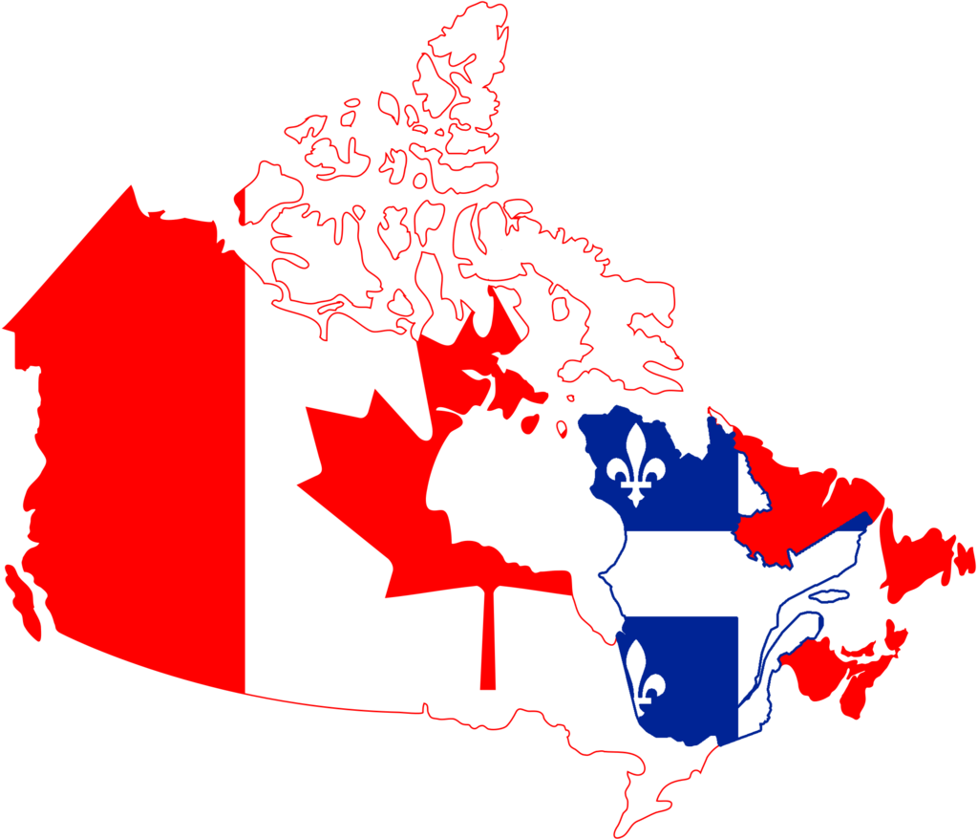
Quebec Issues
Regionalism vs. Separatism
Regionalism - having strong
political and emotional
loyalty to one’s own region
Separatism – belief that certain
parts of a country should
be independent

Slide 9
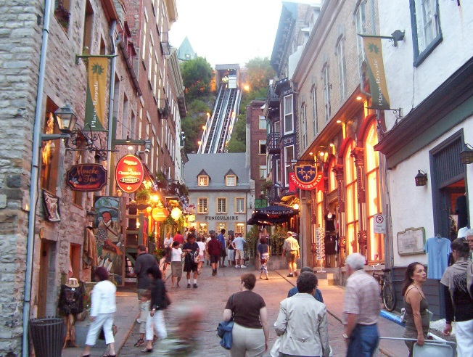
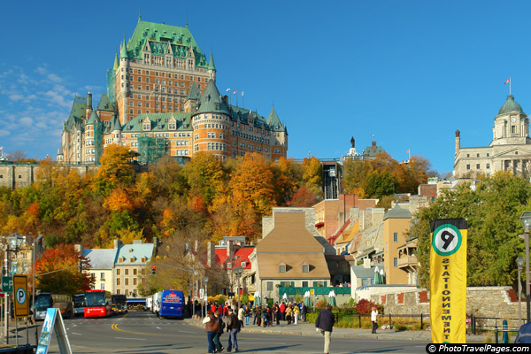
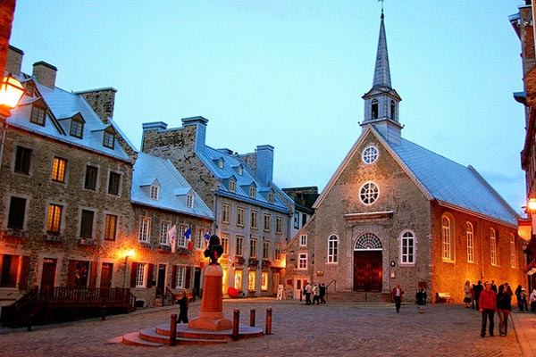
Quebec Issues cont’d
The province of Quebec has the strongest French influence of all Canada
Largely all French speaking and Catholic
More “European” than “American”

Slide 10
ESPN – Natural Environment
U.S.
Landscapes vary (Deserts, Mountains, Coastal Plains, Grasslands, Forests, Tundra)
Fertile, productive lands
Multiple Waterways – Mississippi R. Missouri R. St. Lawrence R. (Canada)
Canada
Mostly boreal forest (taiga; in the south) and tundra (in the north)
Some grasslands in the mid-south
Large portion of land is unusable – due to tundra and Shield
Countries share the 5 Great Lakes
Huron, Erie, Superior, Michigan, Ontario

Slide 11
Canadian Shield

Slide 12
Canadian Shield
Covers about half of Canada
Area of exposed Precambrian Rock – largest in the world
Precambrian Era – 500 million years ago
Made up of metamorphic and igneous rock
Very porous with a thin layer of soil – doesn’t hold moisture well making it poor soil
Glaciation scraped it clean
Rich area for mineral ores – iron, nickel, copper, zinc, etc.

Slide 13
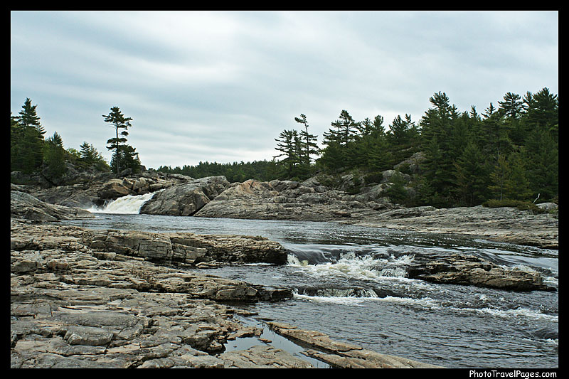
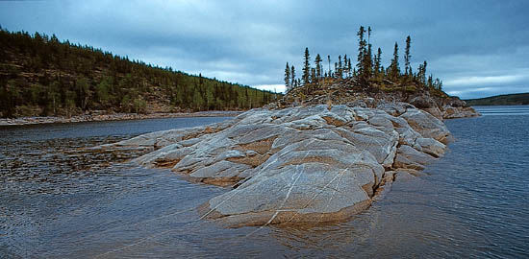

Slide 14
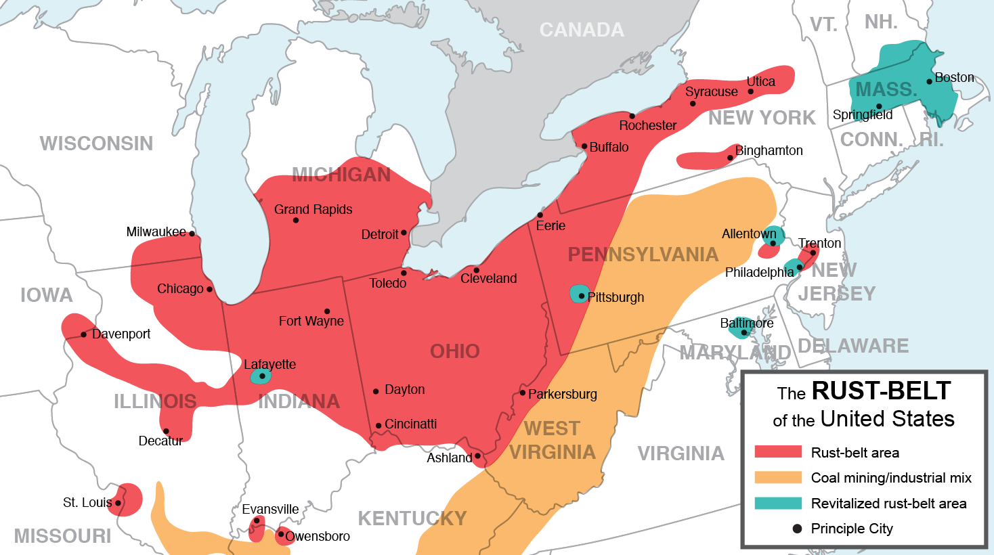
U.S. “Belts”
Rust Belt – once known as the manufacturing belt due to it’s strong industrial sector and steel production; “rust” due to pop. loss, industry decline, and urban decay

Slide 15
Dairy Belt – area in Midwest (Minn. Wisc. Mich.) where dairy production is focused; cattle ranching also common
Sun Belt – region in southern U.S. with long, hot summers and short, mild winters; also characterized by a growing pop. in recent decades due to retiring baby boomers and growing eco. opportunities. Growth has been facilitated by air conditioning.

Slide 16
Sun Belt

