Slide 1
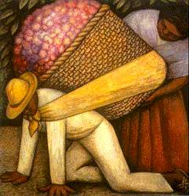
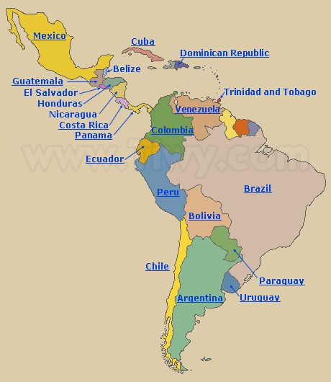
World Cultural Regions
Latin America

Slide 2
Latin America
Region consists of several regions within
Mexico
Caribbean – Cuba, Jamaica, Haiti, Dominican Republic
Central America – Guatemala, Nicaragua, Costa Rica, Panama
South America – Colombia, Venezuela, Brazil, Peru, Chile, Argentina

Slide 3
Latin America
Many highly complex indigenous societies
“Mesoamerica” – refers to Mexico and Central America before Spanish conquest in the 16th cent.
Share history of colonization
Spain in most countries
Portugal in Brazil
French, Dutch, British also settled
Cultural diversity – people of mixed ancestry
United by language and religion
Spanish, Catholicism
Portuguese in Brazil

Slide 4
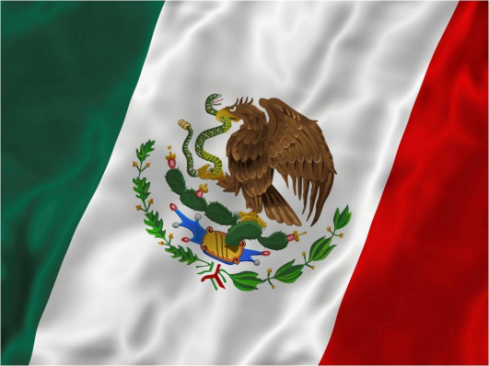
Indigenous Societies - Aztecs
Settled in what is now Mexico City
Lake Texcoco
Capital city of Tenochtitlan
Spoke Nahuatl
Developed a sophisticated system of agriculture
Grew crops such as maize (corn), beans, squash, tomatoes, potatoes, avocados
Kept a powerful military tradition, allowed them to build an empire
Moctezuma (1440) is remembered as the father of the Aztec empire
Aztec faith was polytheistic; included the rite of human sacrifice
Quetzalcoatl (feathered serpent) was an important deity

Slide 5
Fall of the Aztec Empire
Hernan Cortes – founded the city of Vera Cruz and used it to train his army
Formed alliances with native rival tribes
Marched into Tenochtitlan where they were treated as guests
Cuauhtemoc took over the empire, but was unable to win against advanced weaponry
Aztec Empire fell on Aug. 13, 1521
Mexico City was then founded by Spaniards

Slide 6
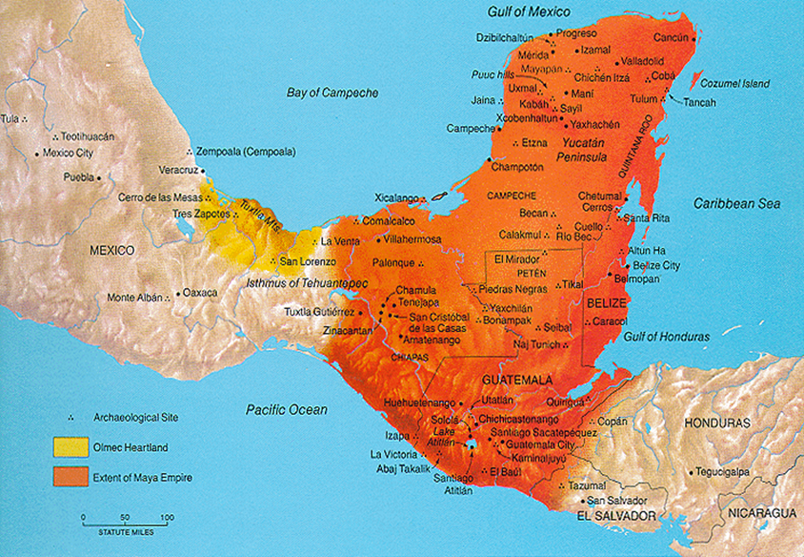
Maya
Settled in the Yucatan Peninsula in a rainforest environment
Made significant advancements in astronomy, mathematics, writing, and engineering
Developed the 0 (zero) and a calendar based on 365 days
Lasted from about
1800 BC to 900 AD
Complex society based
on a social hierarchy
Many different societies
living in different areas

Slide 7
Decline of the Maya
Maya civilization dissipated before the arrival of the Spaniards
No solid reason has been determined for their disappearance, several theories have been developed
Exhaustion of resources
Prolonged drought
Breakdown of social structure

Slide 8
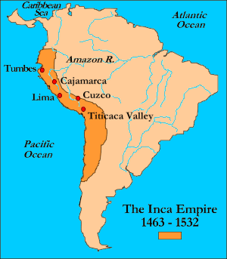
Inca
Early 15th cent. thru 1530
largest empire in the Americas before Spanish conquest
Flourished in the Andean region of South America
Capital city of Cuzco; spoke Quechua

Slide 9
Inca
Built empire without the use of the wheel, draft animals, iron working, or writing system
Built elaborate system of roads and highways all in a mountainous region
Religion was polytheistic – included rite of human sacrifice, also mummification
Conquered by the Spanish led by Francisco Pizarro in the 1530s

Slide 10
ESPN - Economic
Land use – farming, ranching, forestry
Resources – gold, silver, copper, iron, oil, natural gas
Large oil reserves in Mexico, Colombia, Venezuela
Key exports - sugarcane, bananas, oranges, mangoes, coffee, cacao
NAFTA – Mexico
Maquiladoras - assembly plants, factories

Slide 11
ESPN - Economic
Various levels of economic development
Most developed – Chile, Argentina, Uruguay, Costa Rica, Panama
Developing – Mexico, Brazil, Colombia, Venezuela, Peru, Dominican Republic
Underdeveloped – Guatemala, Honduras, Nicaragua, Bolivia, Paraguay

Slide 12
ESPN - Social
Mixture of Spanish and Native traditions
Spanish is dominant language
Portuguese in Brazil
“creole” – a language made up from a mix of two or more languages
Roman Catholicism – dominant religion
Mixed culture
Mestizo – European/Native
Mulatto – European/African
Poverty and gov’t corruption still a huge problem

Slide 13
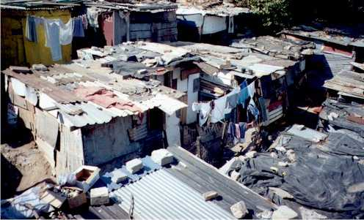
Squatter Settlements (Shanty Town)
An area within a city, usually in a less developed country, in which people illegally establish residences on land they do not own or rent and erect homemade structures usually using scrap materials
Notes:
Paracaidistas

Slide 14
Favelas – slums in Brazil

Slide 15
ESPN - Political
Colonialism – Spanish conquest in 16th cent.
Independence
Most gained independence between 1804-1830
Oligarchy – rule by a few
Caudillo – military dictator; particularly in Central America
Democracy is now widespread, but struggles due to lack of political, economic and land reforms
Gov’t corruption – bribes are a big problem
Drug cartels are rampant and have lots of control and influence
Mexico, Colombia

Slide 16
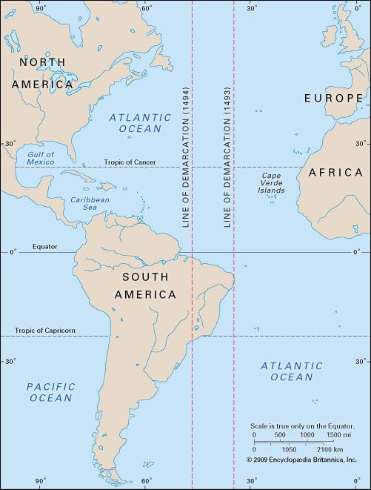
Treaty of Tordesillas
Signed on May 4, 1493 by Pope Alexander VI
Meant to settle disputes over newly discovered lands
Divided the globe into
land for Spain and
Portugal
Revised on June 7, 1494 after Portugal realized Spain had been granted most of the land

Slide 17
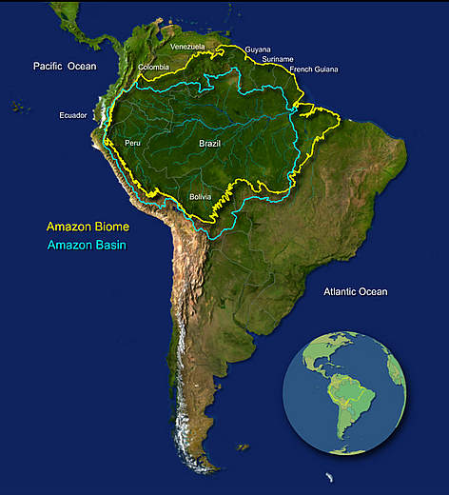
ESPN – Natural Environment
Many different biomes/lanscapes
Rainforest – throughout Central America and the Amazon in central South America
Amazon
Largest remaining rainforest
Houses 10% of known
biodiversity
Home to 350+ ethnic groups
Faces threat of deforestation

Slide 18
Uncontacted Tribes of the Amazon

Slide 19
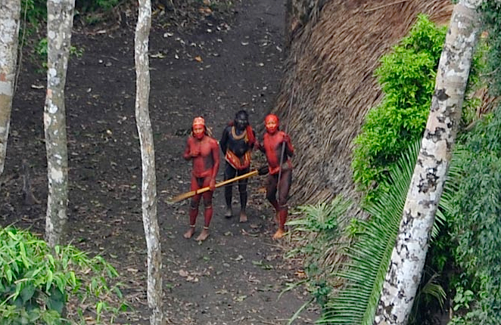
http://youtu.be/sLErPqqCC54

Slide 20
ESPN – Natural Environment
Pampas (savanna) – in Brazil and Argentina
Fertile grasslands, agriculturally productive
Desert
Sonoran in Northern Mexico
Atacama in southern Peru and Chile
Driest place on Earth
Highlands
Sierra Madre ranges throughout Mexico
Andes mountains along western coast of S.A.

Slide 21
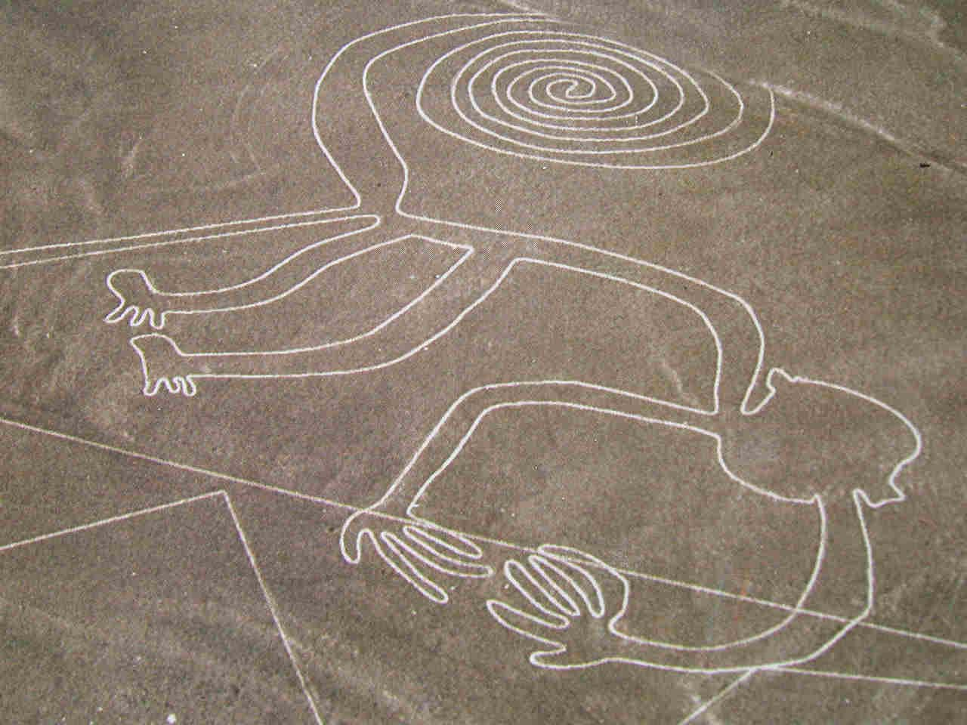
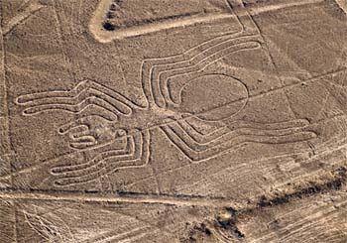
Nazca Lines
Series of ancient geoglyphs located in Nazca desert in southern Peru
Contain many zoomorphic shapes – animals

Slide 22
ESPN – Natural Environment
Ecotourism - responsible travel to natural areas that conserves the environment and improves the well-being of local people
Minimize impact.
Build environmental and cultural awareness and respect.
Provide positive experiences for both visitors and hosts.
Provide direct financial benefits for conservation.
Provide financial benefits and empowerment for local people.
Raise sensitivity to host countries' political, environmental, and social climate.

